Slide 1




DESIGN PATTERNS
LOW LEVEL DESIGN
( LLD )

Slide 2
THERE ARE TOTALLY 23 DESIGN PATTERNS PRESENT.
WE CALLED IT GoF (GOLF of FOUR) MEANS 4 AUTHORS CREATED THIS 23 DESIGN PATTERNS.
THESE 23 DESIGN PATTERNS ARE DIVIDED UNDER THREE CATEGORIES.
LET’S DISCOVER IT

Slide 3
3 TYPES OF DESIGN PATTERNS
PATTERN 1
CREATIONAL
PATTERN 2
STRUCTURAL
PATTERN 3
BEHAVIORAL

Slide 4
4 TYPES OF DESIGN PATTERNS COMES UNDER CREATIONAL
SINGLETON
FACTORY METHOD
BUILDER
PROTOTYPE

Slide 5
7 TYPES OF DESIGN PATTERNS COMES UNDER STRUCTURAL
BRIDGE
COMPOSITE
ADAPTER
DECORATOR
FACADE
FLYWEIGHT
PROXY

Slide 6
11 TYPES OF DESIGN PATTERNS COMES UNDER BEHAVIORAL
OBSERVER
STARTGEY
ITERATOR
COMMAND
STATE
TEMPLATE METHOD
VISITOR
MEDIATOR
MEMENTO
CHAIN OF RESPONSIBILITY
INTERPRETER

Slide 7
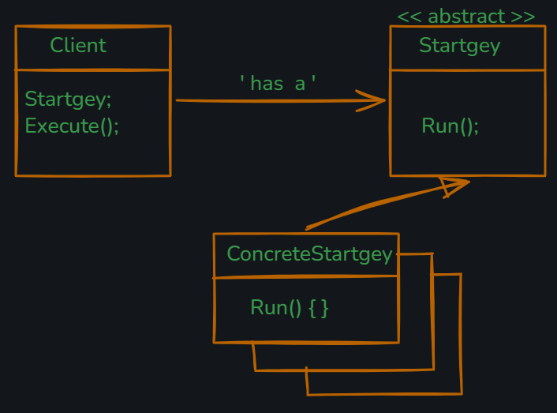
1. STARTGEY DESIGN PATTERN DEFINES A FAMILY OF ALGORITHM, PUT THEM INTO SEPARATE CLASSES SO THAT THEY CAN BE CHANGED AT RUN TIME.

Slide 8
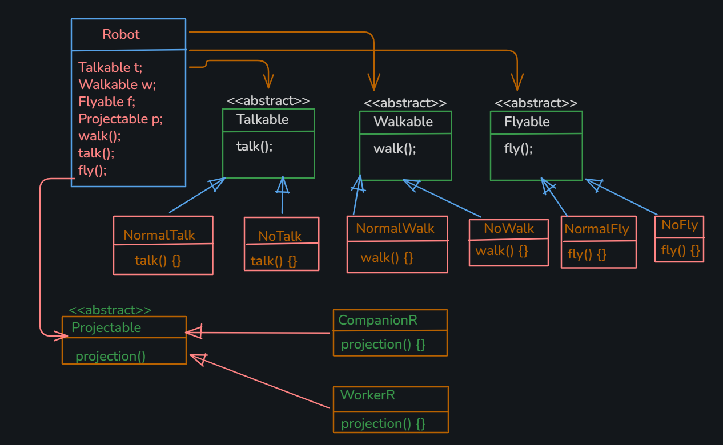
EXAMPLE UML

Slide 9
2. FACTORY DESIGN PATTERN
THERE ARE THREE TYPES OF FACTORY DESIGN METHOD :-
I. SIMPLE FACTORY
II. FACTORY METHOD
III. ABSTRACT FACTORY METHOD

Slide 10
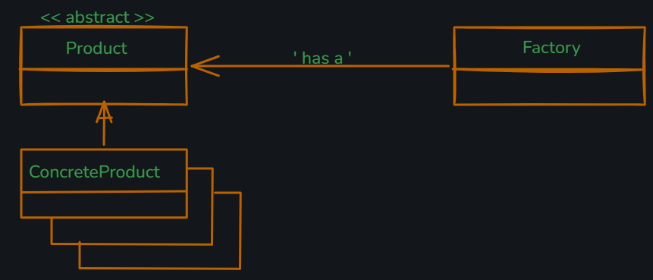
I. SIMPLE FACTORY A FACTORY CLASS THAT DECIDES WHICH CONCRETE CLASS TO INSTANTIATE.

Slide 11
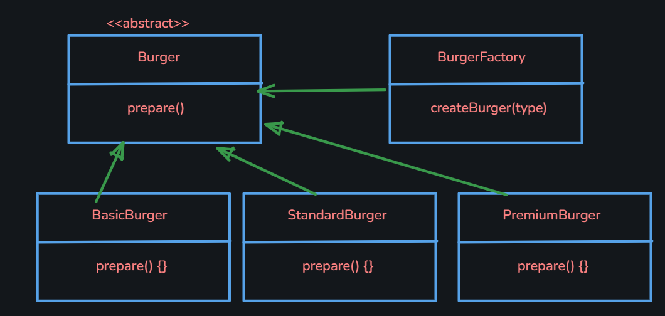
EXAMPLE UML

Slide 12
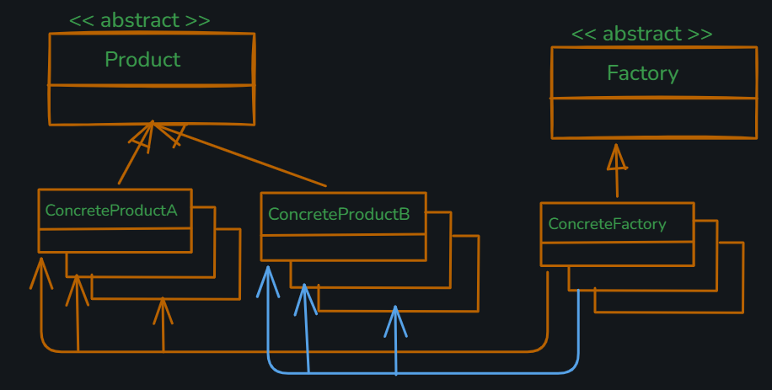
II. FACTORY METHOD DEFINES AN INTERFACE FOR CREATING OBJECTS BUT ALLOWS SUBCLASSES TO DECIDES WHICH CLASS TO INSTANTIATE.

Slide 13
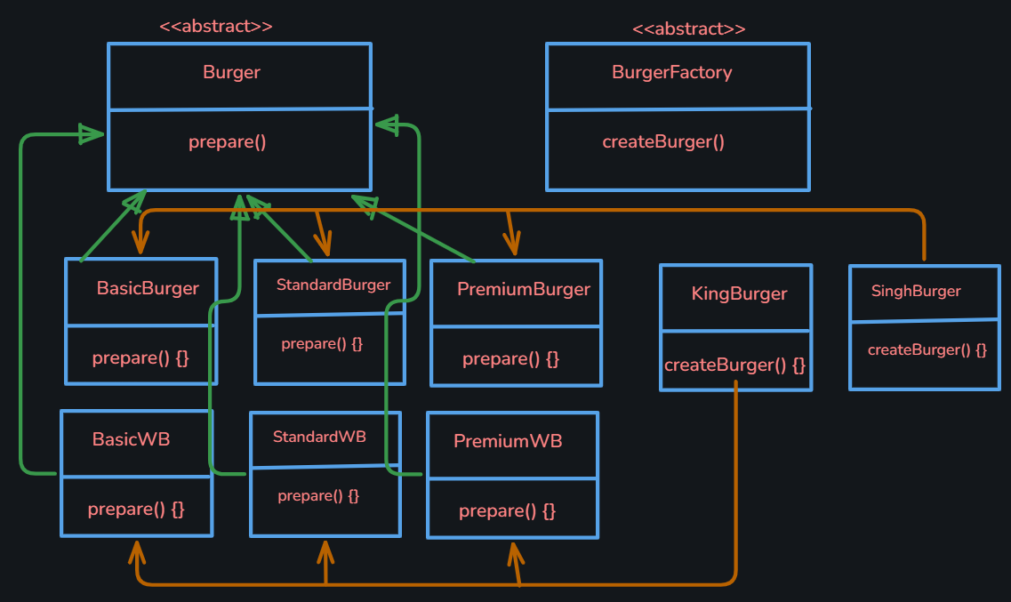
EXAMPLE UML

Slide 14
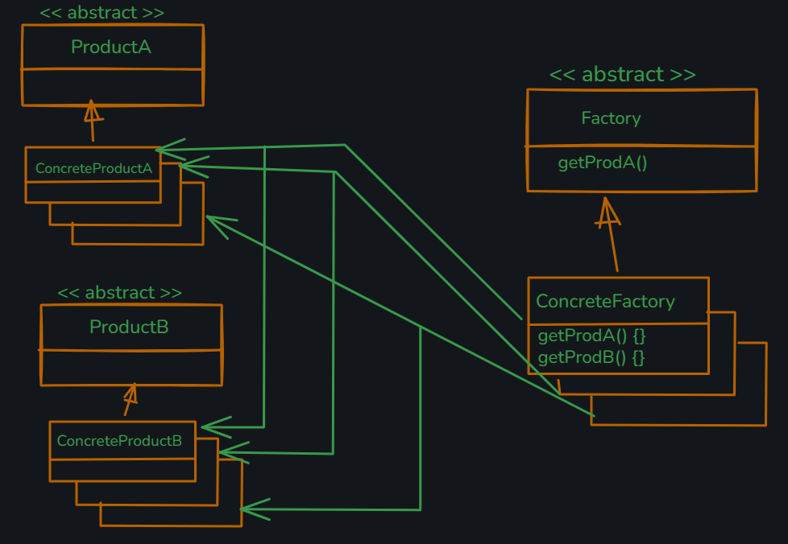
III. ABSTRACT FACTORY METHOD PROVIDES AN INTERFACE FOR CREATING FAMILIES OF RELATED OBJECTS WITHOUT SPECIFYING THERE CONCRETE CLASSES.

Slide 15
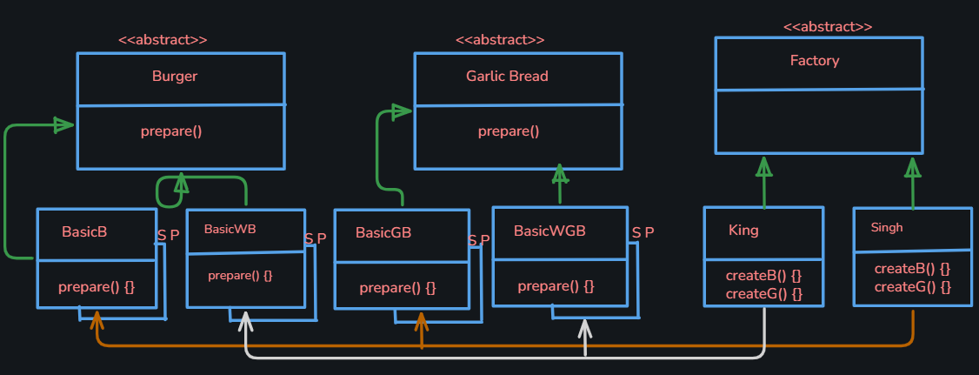
EXAMPLE UML

Slide 16
3. SINGLETON DESIGN PATTERN
SINGLETON IS A SPECIAL TYPE OF CLASS, BY USING WHICH WE CREATE ONLY ONE
OBJECT / INSTANCE. NO MULTIPLE OBJECTS.
FOR SINGLETON DESIGN PATTERN :
-> CREATE A PRIVATE CONSTRUCTOR
-> CREATE A STATIC INSTANCE THAT RETURN THE SAME INSTANCE EVERY TIME

Slide 17
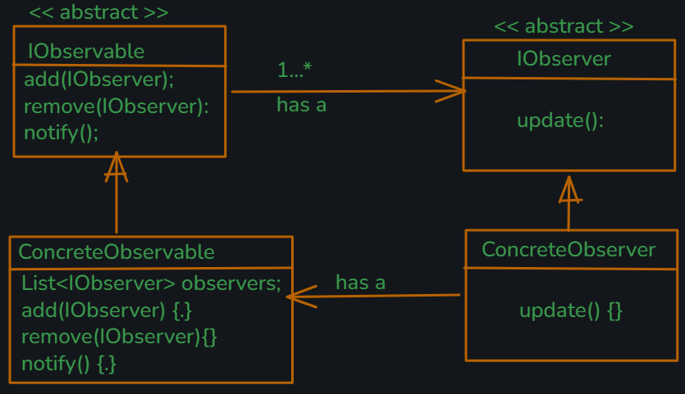
4. OBSERVER DESIGN PATTERN DEFINES A ONE-TO-MANY RELATIONSHIP BETWEEN OBJECTS, SO THAT WHEN ONE OBJECT CHANGES THE STATE, ALL OF ITS DEPENDENT ARE NOTIFIED AND UPDATED AUTOMATICALLY.

Slide 18
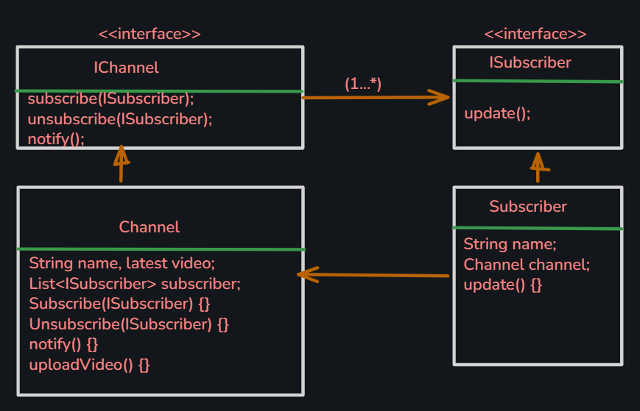
EXAMPLE UML

Slide 19
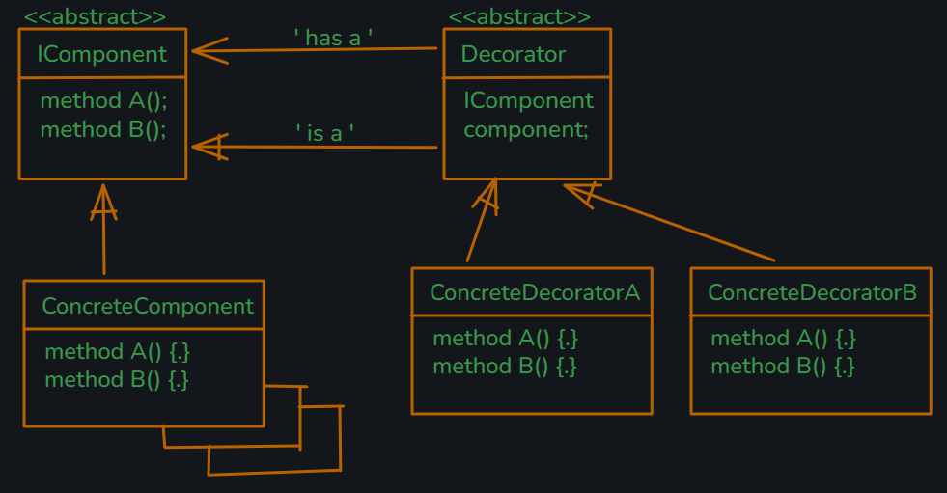
5. DECORATOR DESIGN PATTERN DECORATOR PATTERN ATTACHES ADDITIONAL RESPONSIBILITIES TO AN OBJECT DYNAMICALLY. DECORATOR PROVIDES A FLEXIBLE ALTERNATIVE TO SUBCLASSING FOR EXTENDING FUNCTIONALITY.

Slide 20
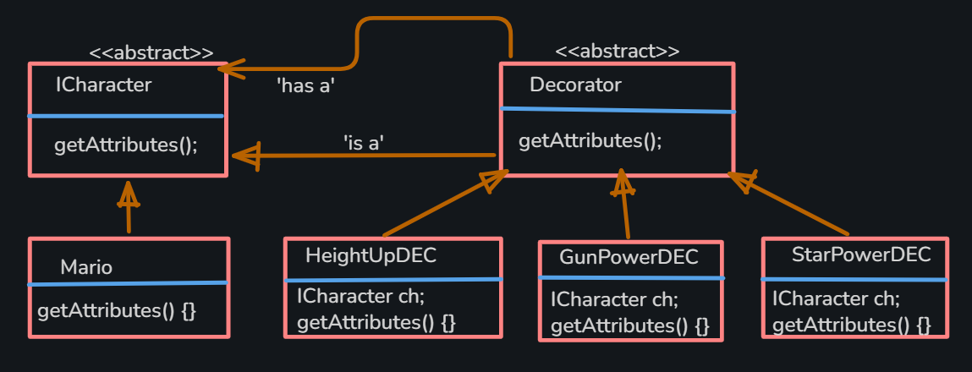
EXAMPLE UML

Slide 21
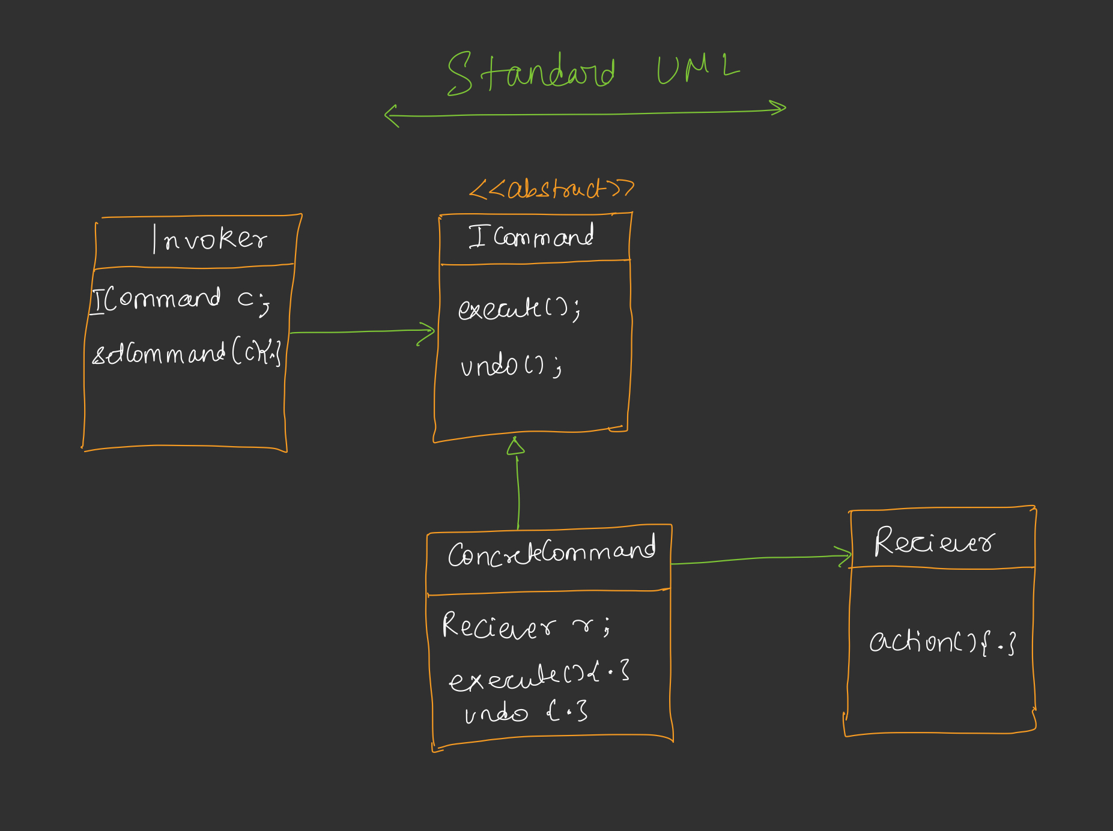
6. COMMAND DESIGN PATTERN ENCAPSULATE A REQUEST AS AN OBJECT, THEREBY LETTING YOU PARAMETERIGE CLIENTS WITH DIFFERENT REQUEEST, QUEUE OR LOG REQUEST AND SUPPORT UNDOABLE OPERATIONS.

Slide 22
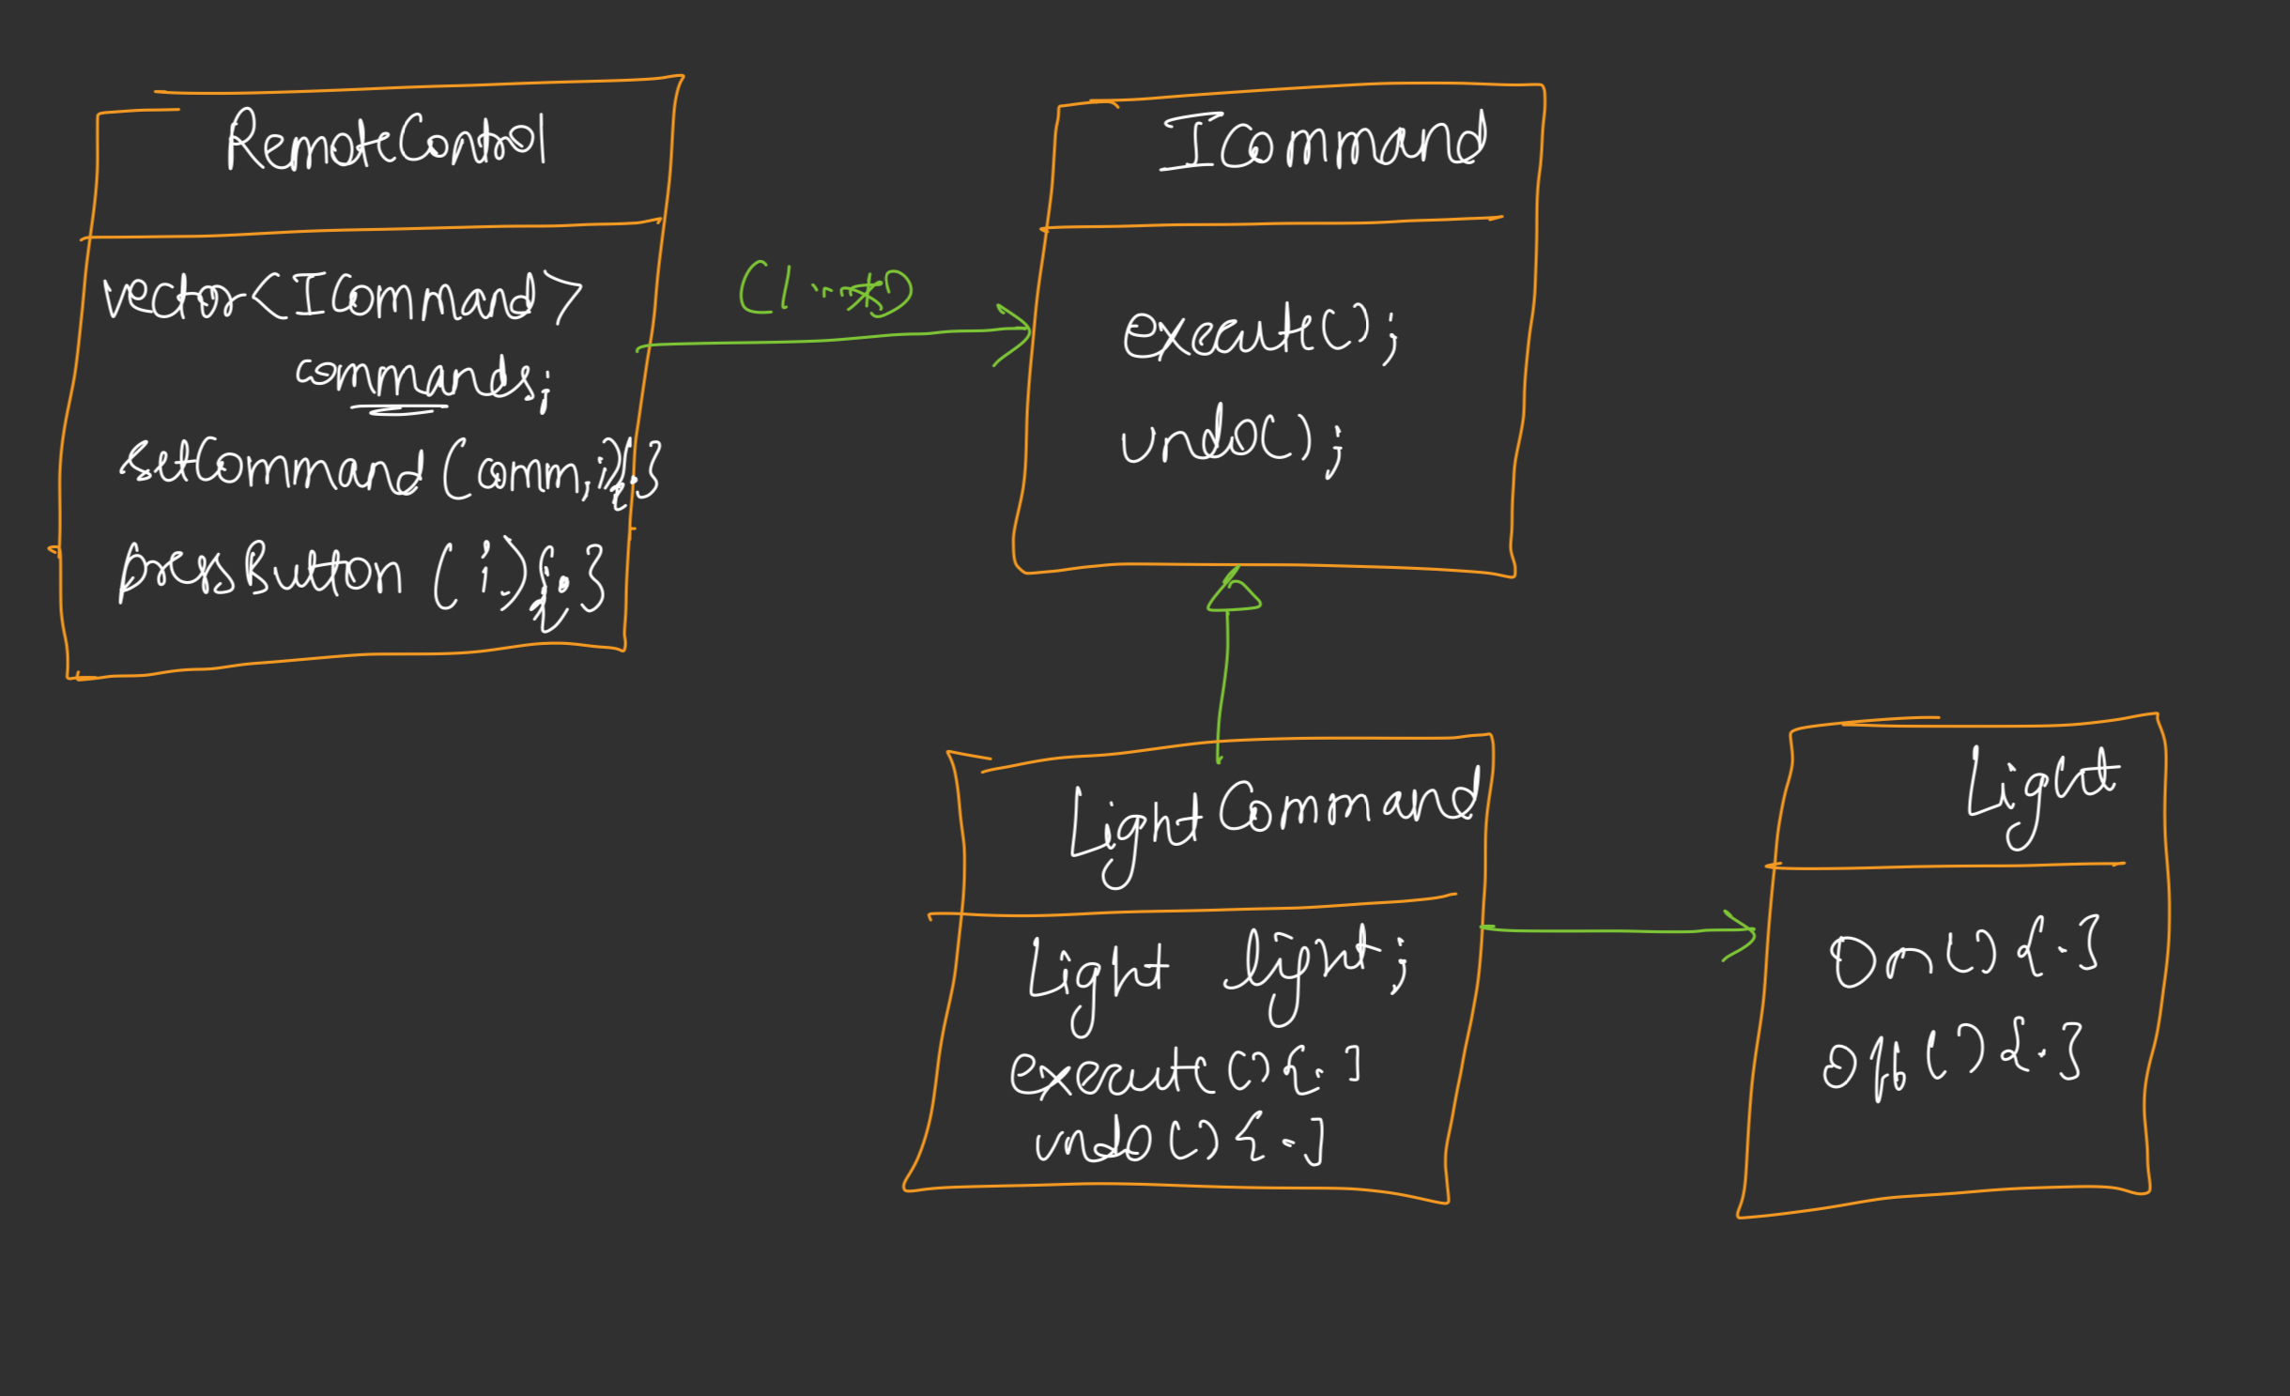
EXAMPLE UML

Slide 23
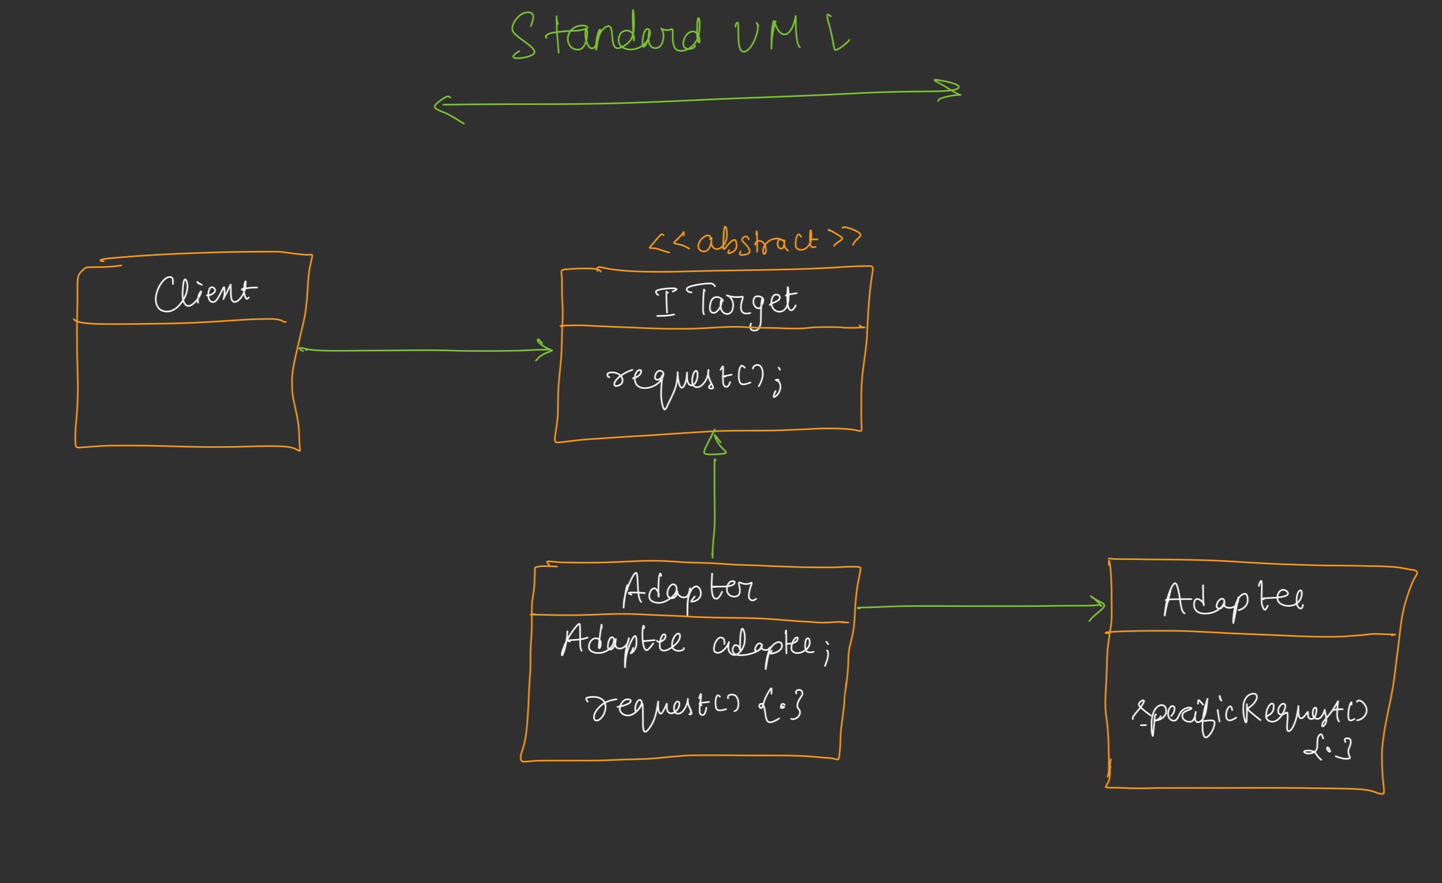
7. ADAPTER DESIGN PATTERN ADAPTER CONVERTS THE INTERFACE OF A CLASS INTO ANOTHER INTERFACE THAT CLIENT EXPECTS. ADAPTER LETS CLASSESS WORK TOGETHER THAT COULD NOT OTHERWISE BECAUSE OF INCOMPATIBLE INTERFACE.

Slide 24
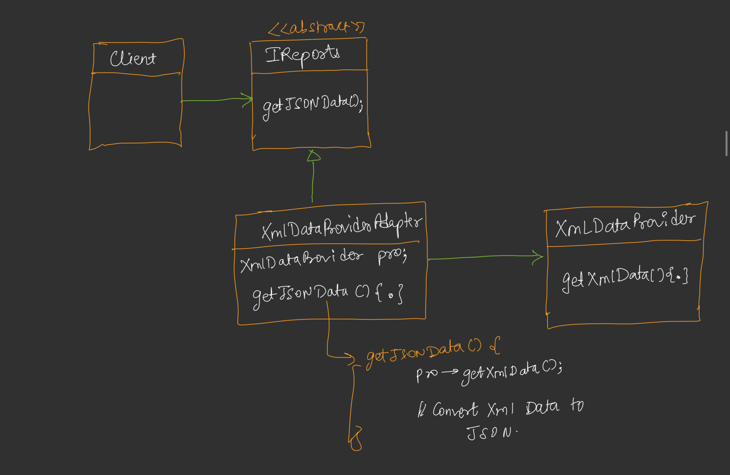
EXAMPLE UML

Slide 25
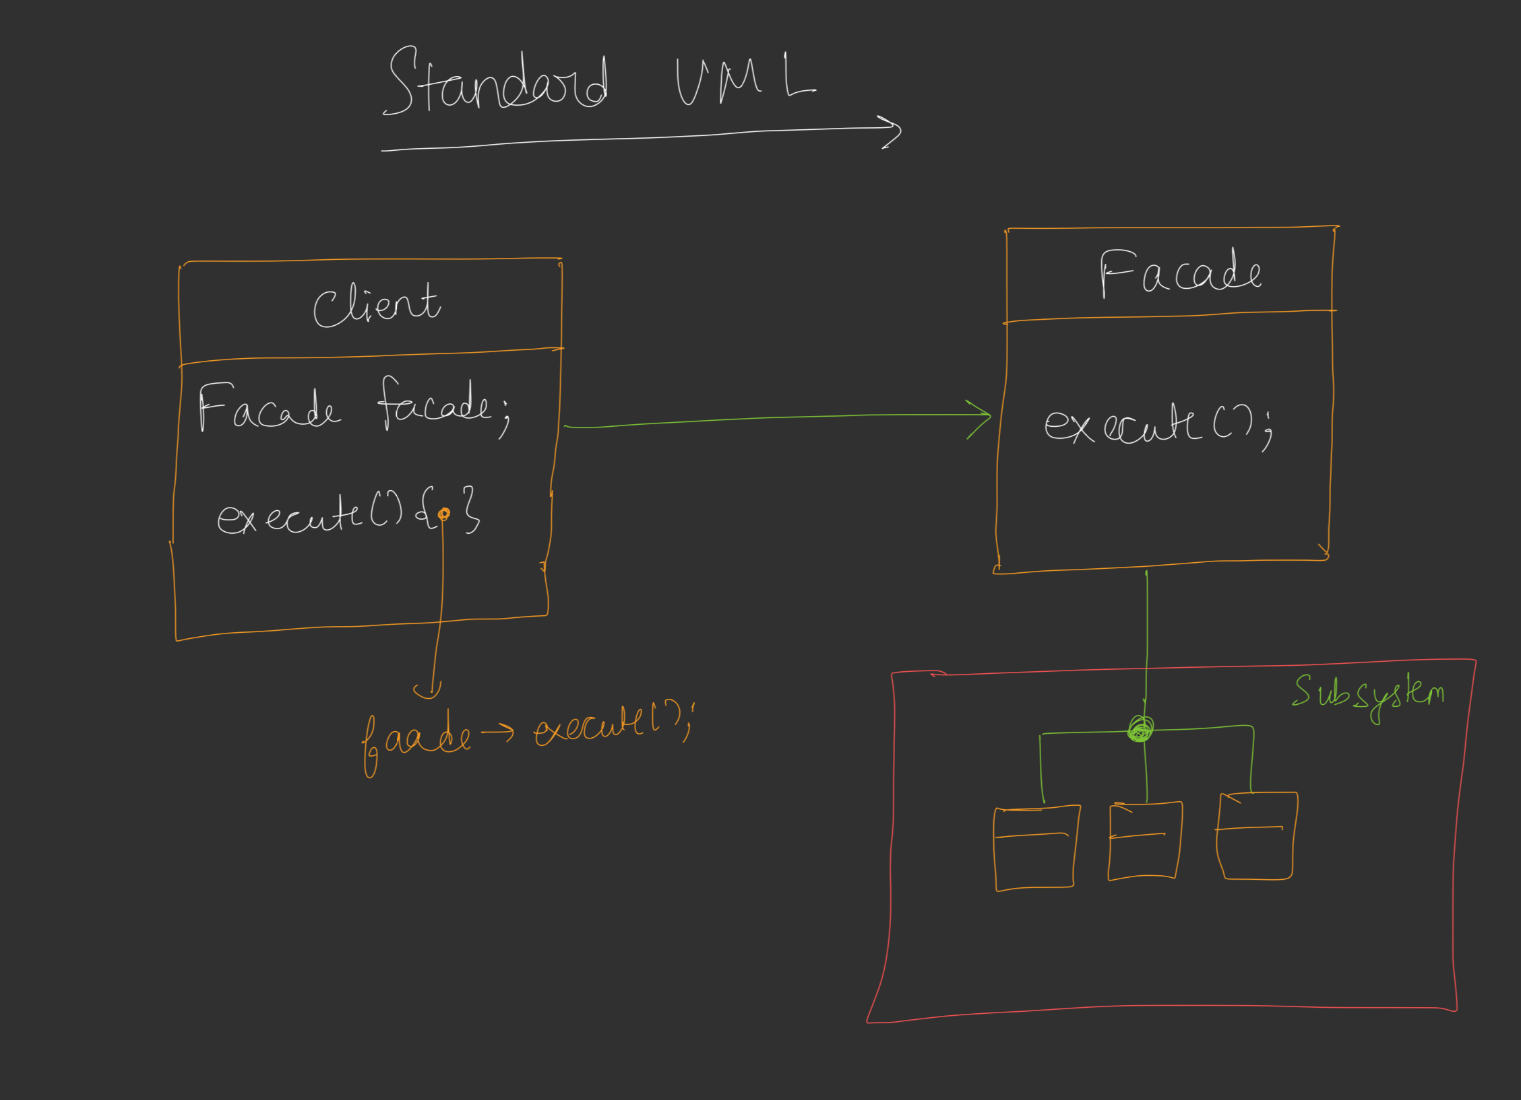
8. FACADE DESIGN PATTERN IT PROVIDES A SIMPLIFIED, UNIFIED INTERFACE TO A SET OF COMPLEX SUBSYSTEM. IT HIDES THE COMPLEXITY OF THE SYSTEM AND EXPOSES ONLY WHAT IS NECESSARY.

Slide 26
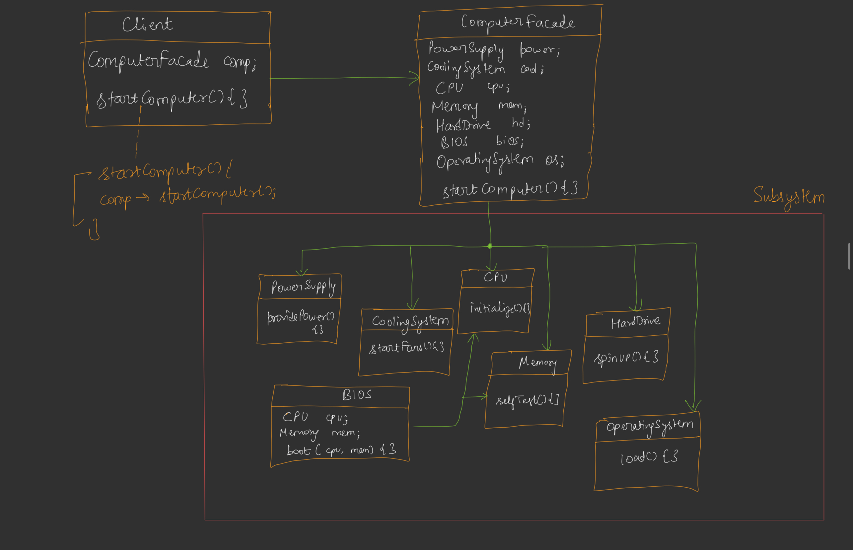
EXAMPLE UML

Slide 27
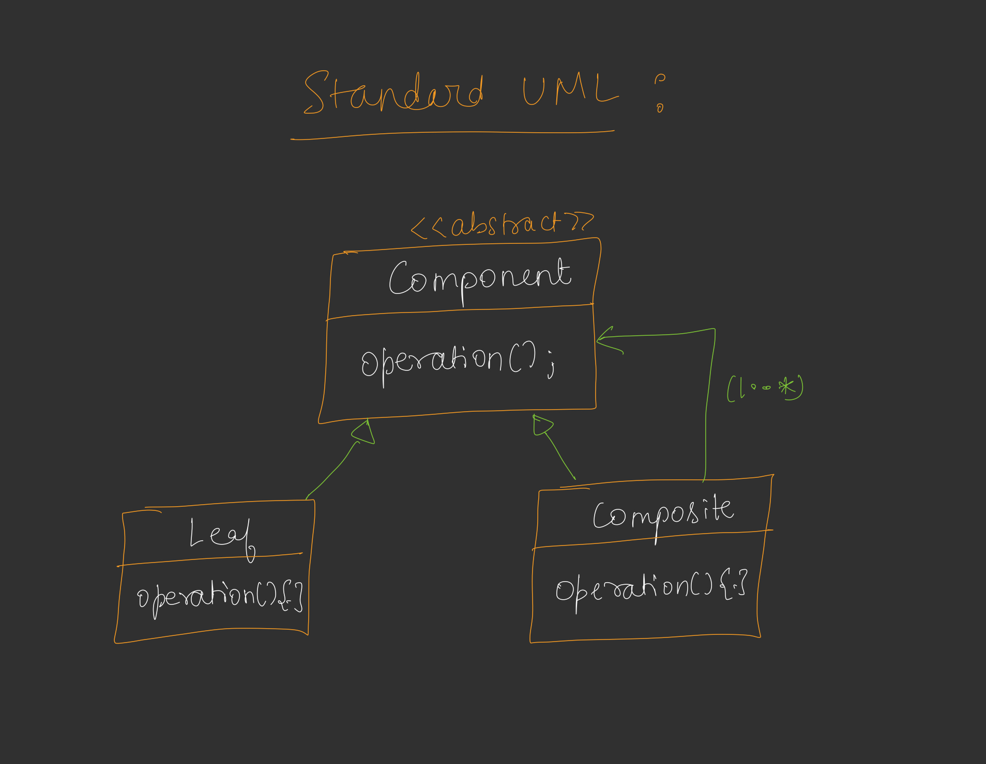
9. COMPOSITE DESIGN PATTERN IT COMPOSES OBJECT INTO TREE- LIKE STRUCTURE REPRESENTING A PART-WHOLE HIERARCHY. IT LET CLIENT TREATS INDIVIDUAL OBJECT AND COMPOSITION OF OBJECT UNIFORMLY.

Slide 28
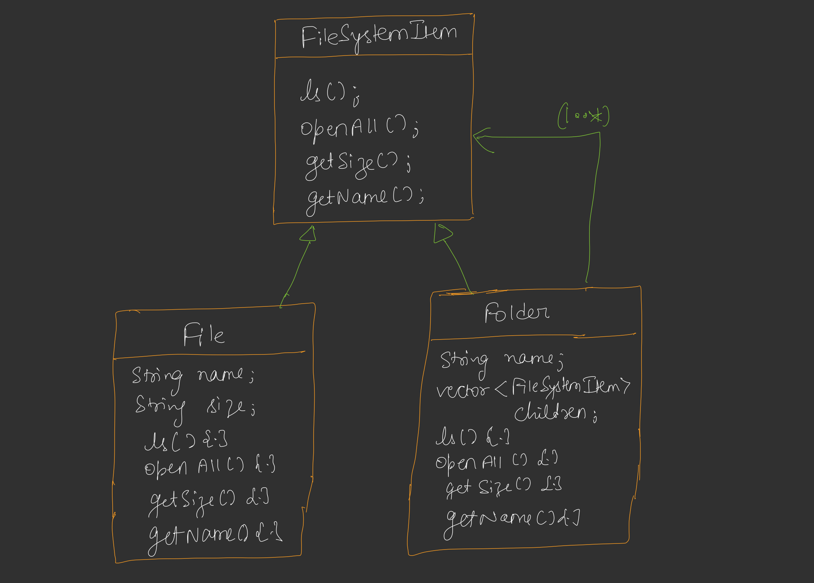
EXAMPLE UML

Slide 29
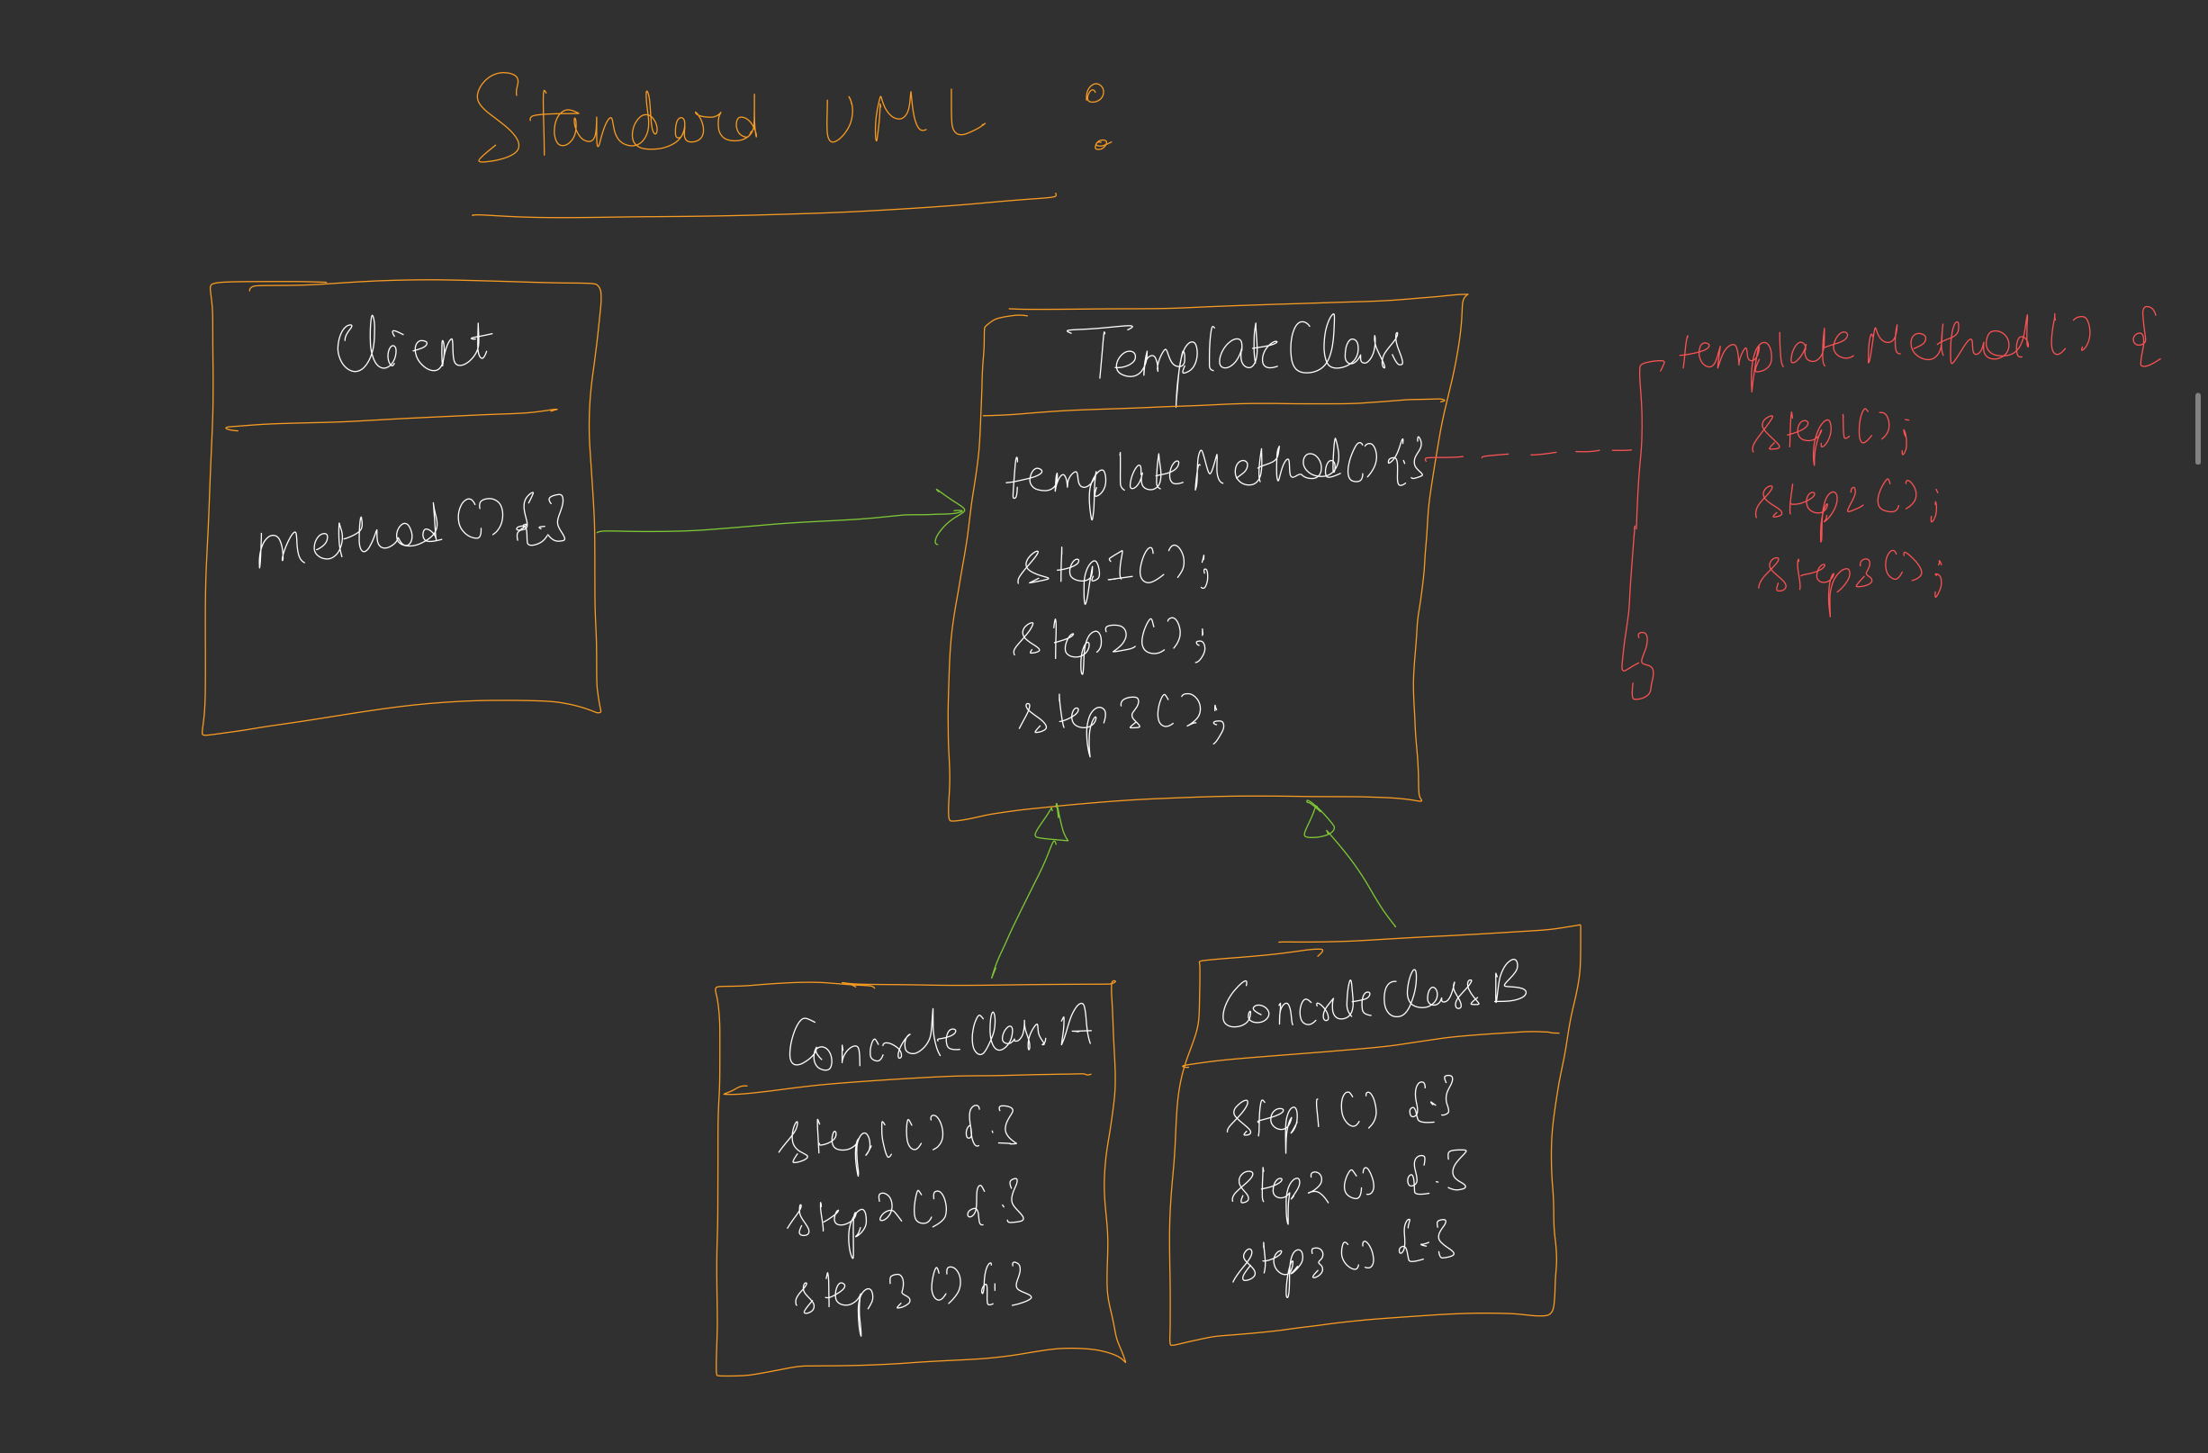
10. TEMPLATE METHOD DESIGN PATTERN IT DESIGN THE SKELETON OF AN ALGORITHM FOR AN OPERATION DEFERING SOME STEPS TO SUBCLASSES. TEMPLATE METHOD LET SUBCLASSES REDEFINE CERTAIN STEPS OF AN ALGORITHM WITHOUT CHANGING THE ALGORITHM STRUCTURE.

Slide 30
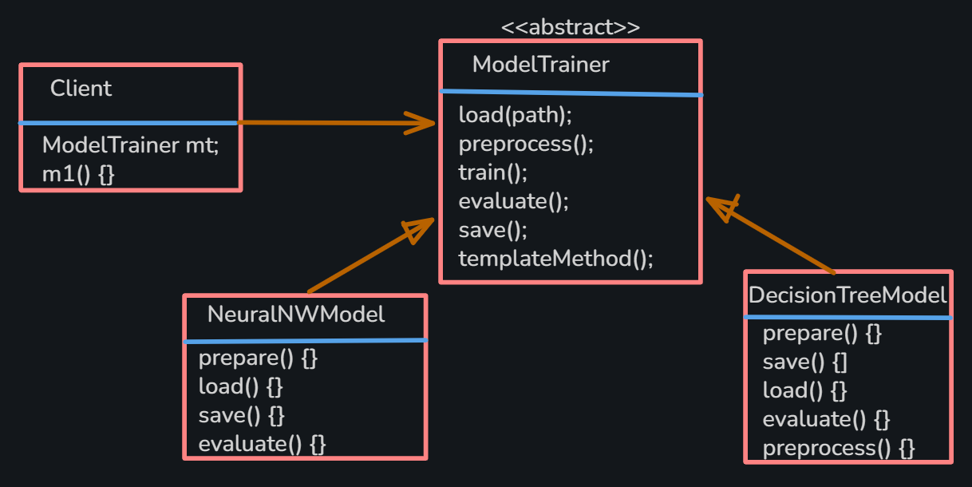
EXAMPLE UML

Slide 31
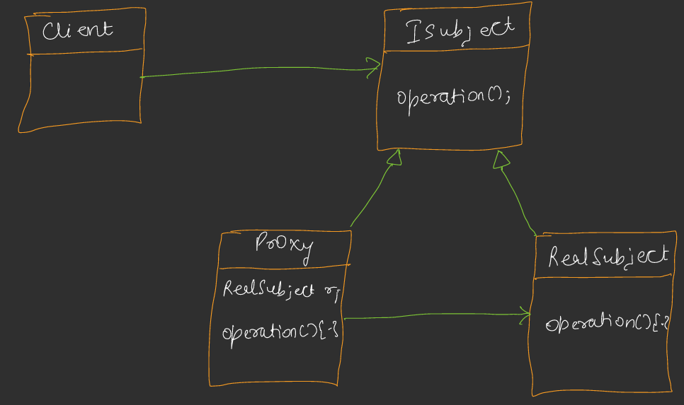
11. PROXY DESIGN PATTERN IT PROVIDES A SURROGATE OR PLACEHOLDER FOR ANOTHER OBJECT TO CONTROL ACCESS TO IT: -> REMOTE PROXY -> VIRTUAL PROXY -> PROTECTION PROXY

Slide 32
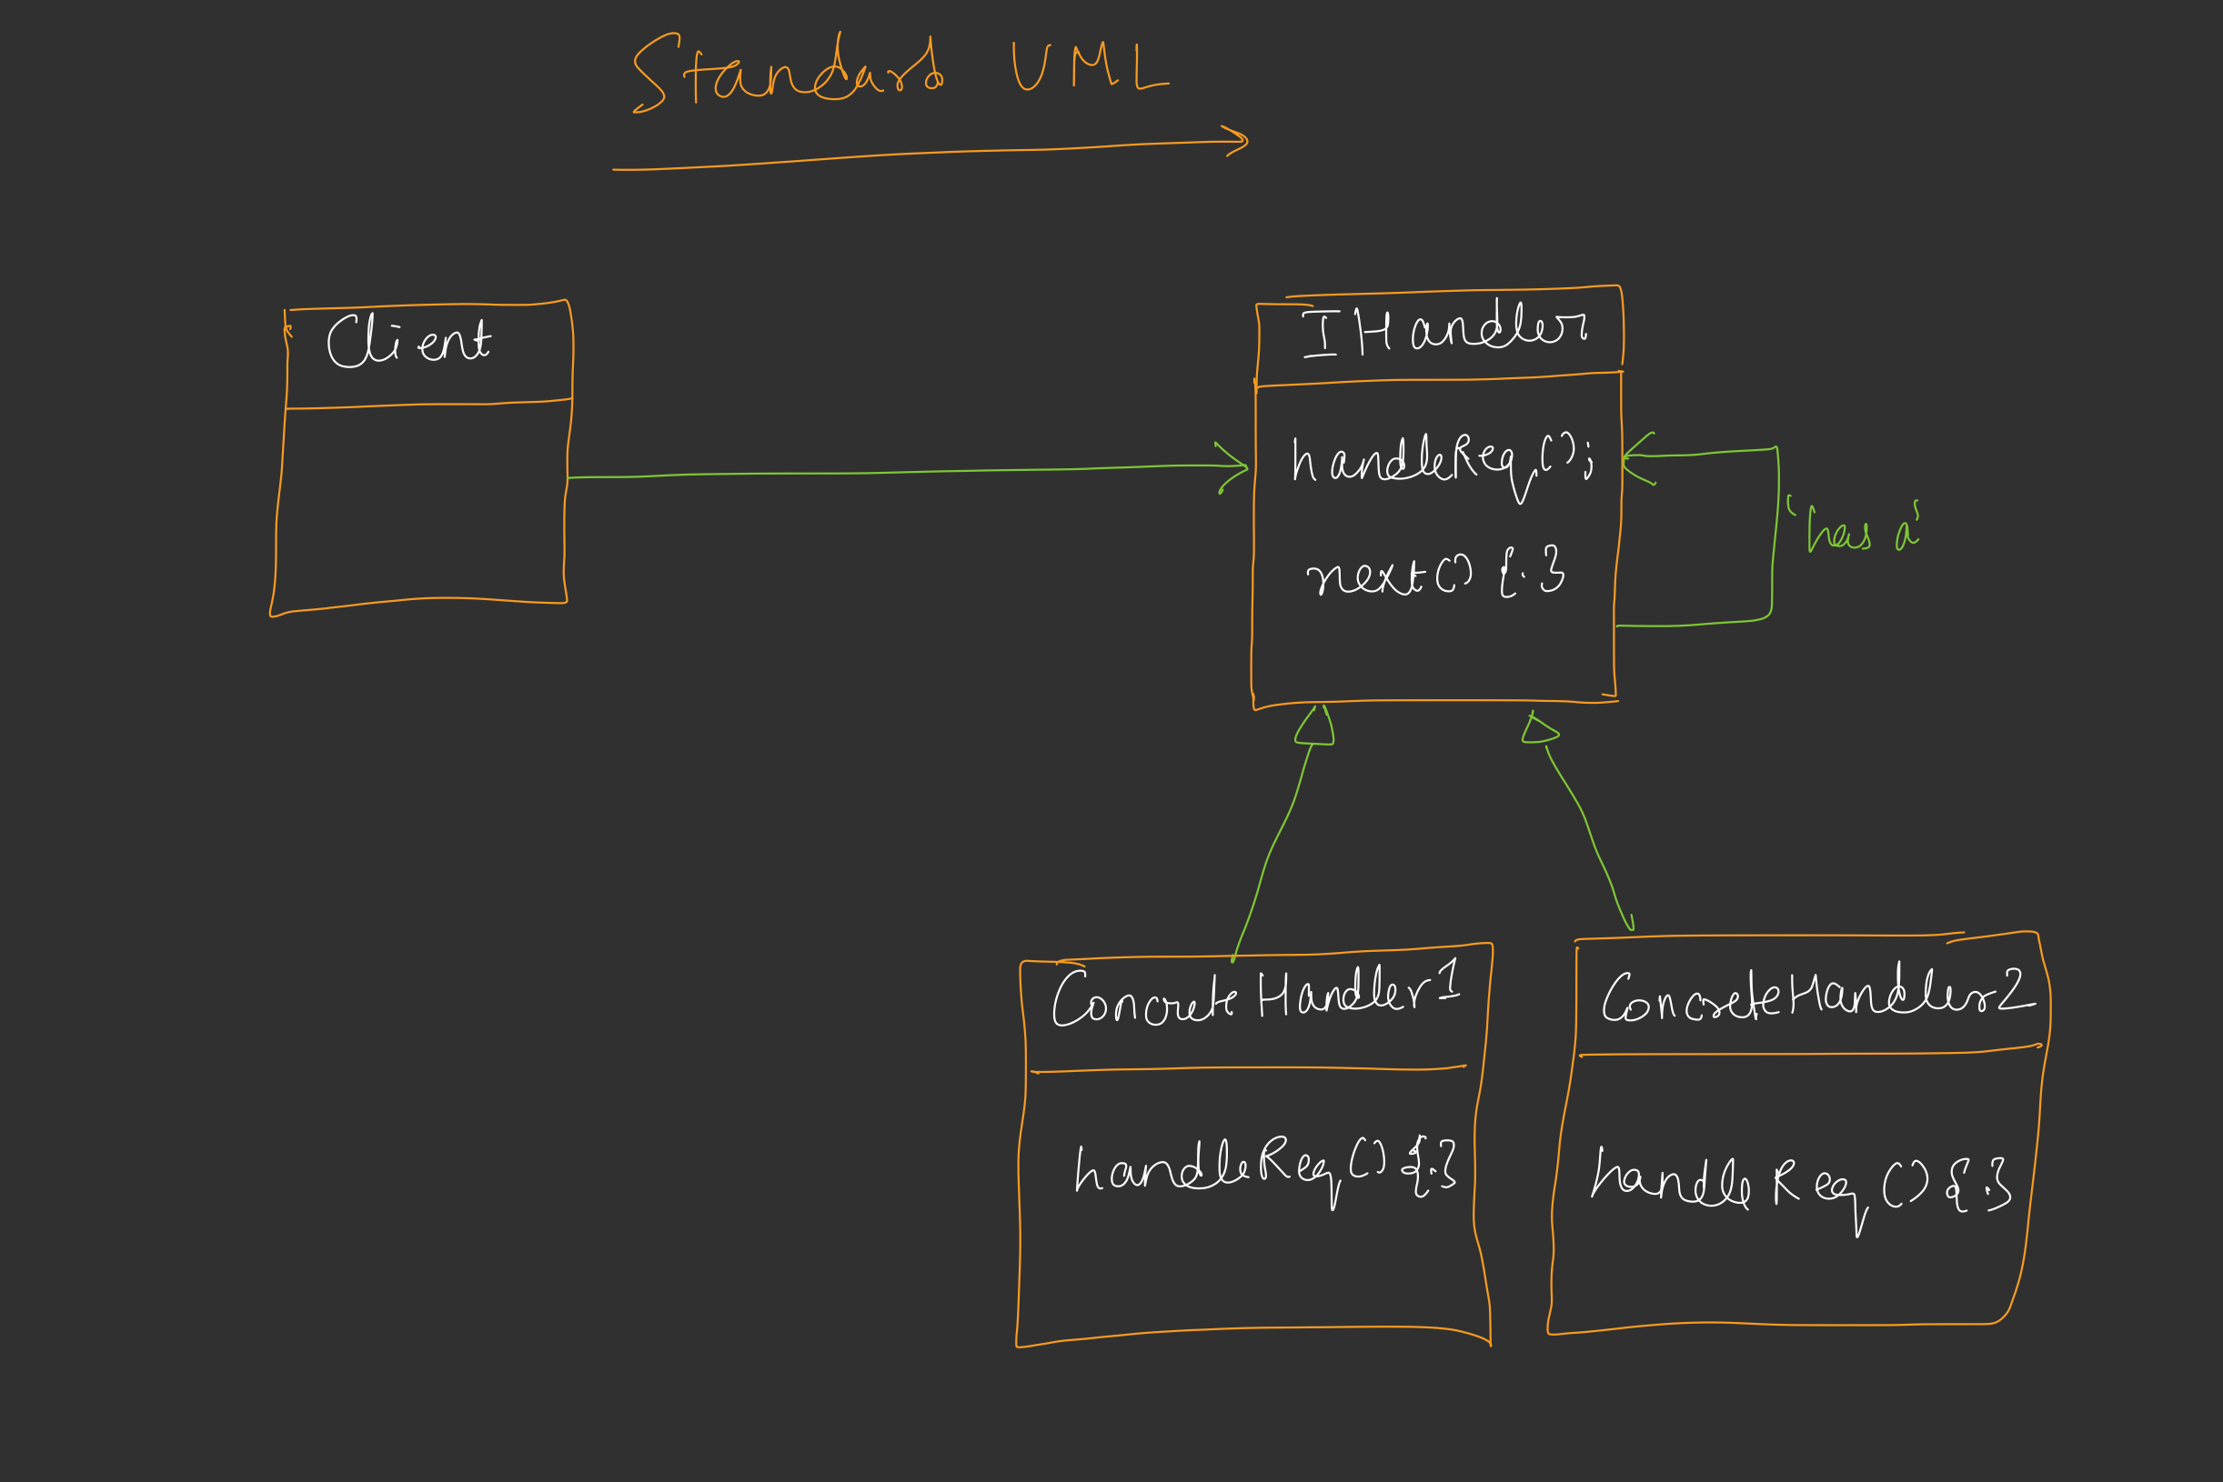
12. CHAIN OF RESPONSIBILITY DESIGN PATTERN ALLOW AN OBJECT TO PASS A REQUEST ALONG A CHAIN OF POTENTIAL HANDLERS. EACH HANDLER IN THE CHAIN DECIDES EITHER TO PROCESS THE REQUEST OR PASS IT TO THE NEXT HANDLER.

Slide 33
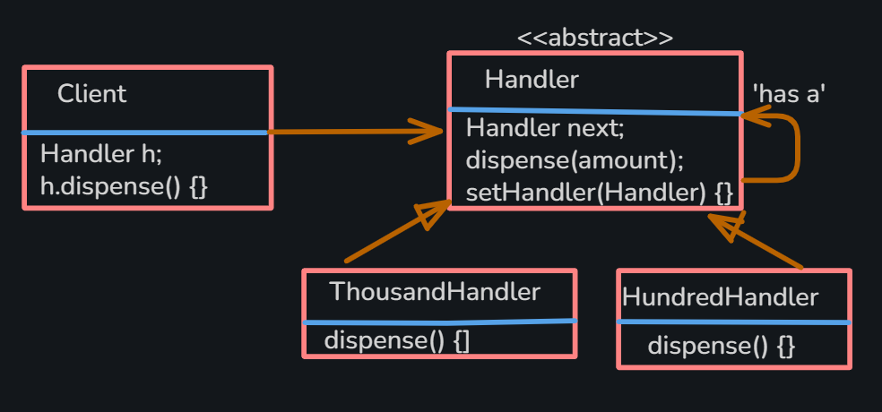
EXAMPLE UML

Slide 34
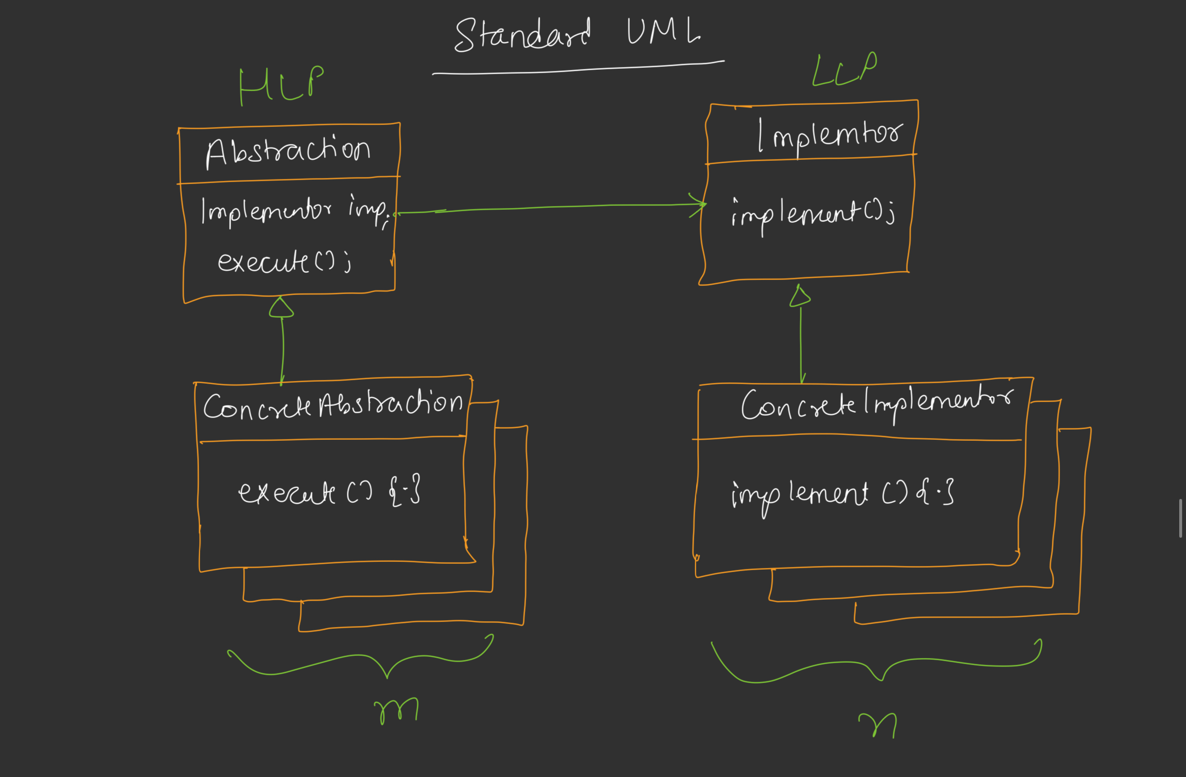
13. BRIDGE DESIGN PATTERN BRIDGE DECOUPLES AN ABSTRACTION FROM ITS IMPLEMENTATIONS, SO THAT BOTH CAN VARY INDEPENDENTLY. ABSTRACTIONS – HIGH LEVEL LAYER IMPLEMENTATIONS – LOW LEVEL LAYER

Slide 35
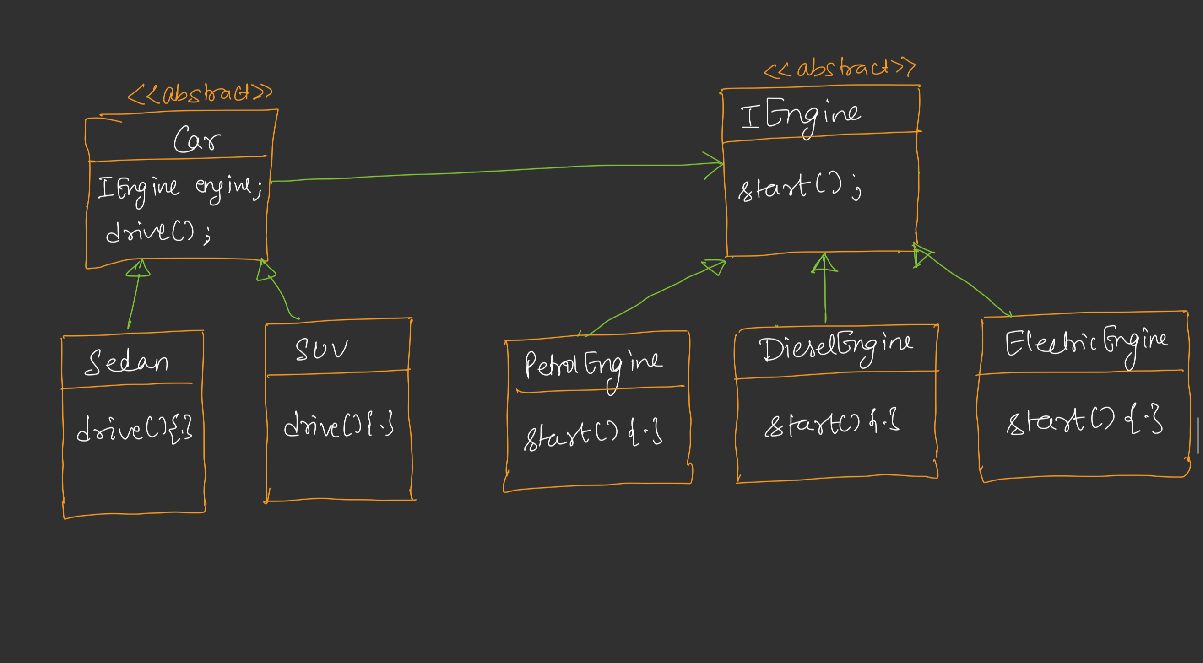
EXAMPLE UML

Slide 36
14. BUILDER DESIGN PATTERN
BUILDER SEPARATES THE CONSTRUCTION OF A COMPLEX OBJECT FROM ITS REPRESENTATION.
I. SIMPLE BUILDER
II. DIRECTOR BUILDER
III. STEP BUILDER

Slide 37
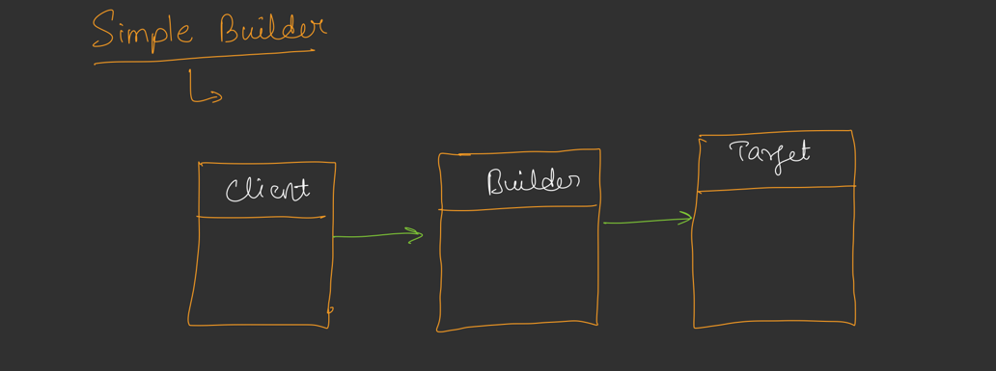
I. SIMPLE BUILDER => CLEAR, READABLE OBJECT CONSTRUCTION. => SINGLE CENTRALIZED VALIDATION. => IMMUTABLE OBJECTS. => NO CONSTRUCTOR OVERLOAD.

Slide 38
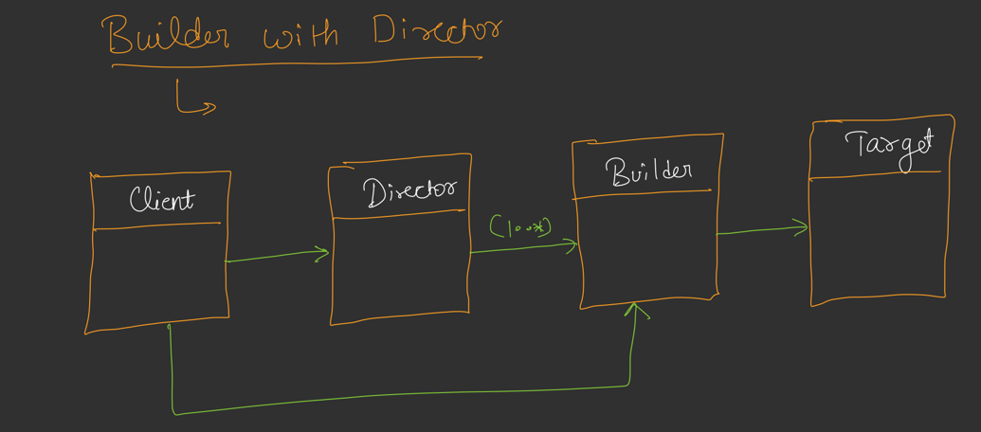
II. DIRECTOR BUILDER => REUSABLE BUILDS.

Slide 39
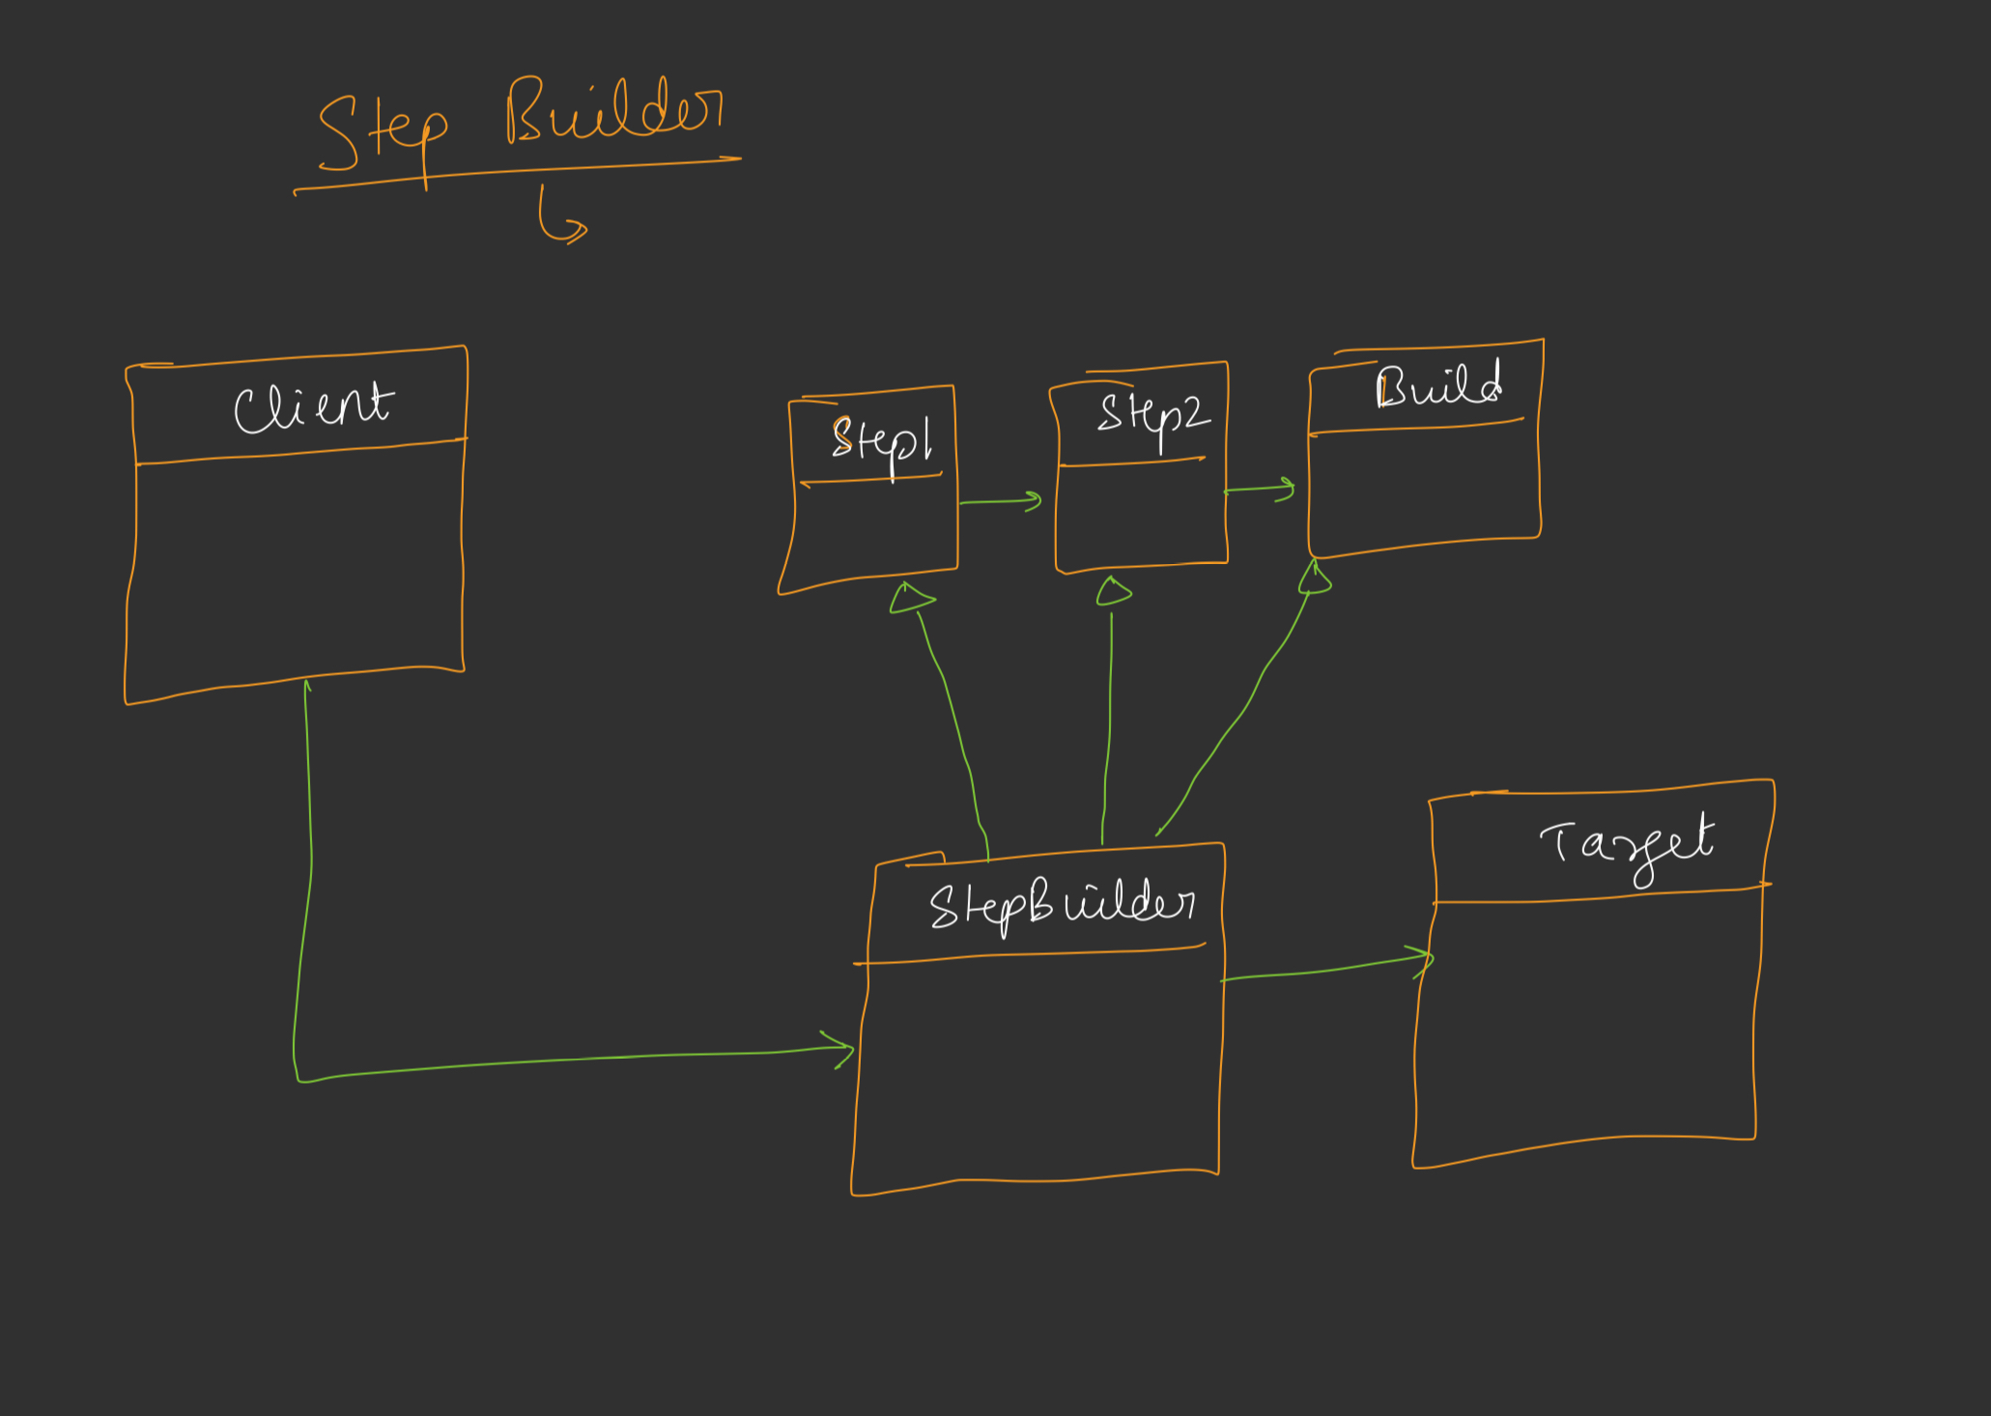
III. STEP BUILDER => INCREMENTAL/COMPILE TIME ENFORCEMENT OF ALL REQUIRED FIELDS. => SEPARATION OF MANDATORY VS OPTIONAL. => IDE FRIENDLY.

Slide 40
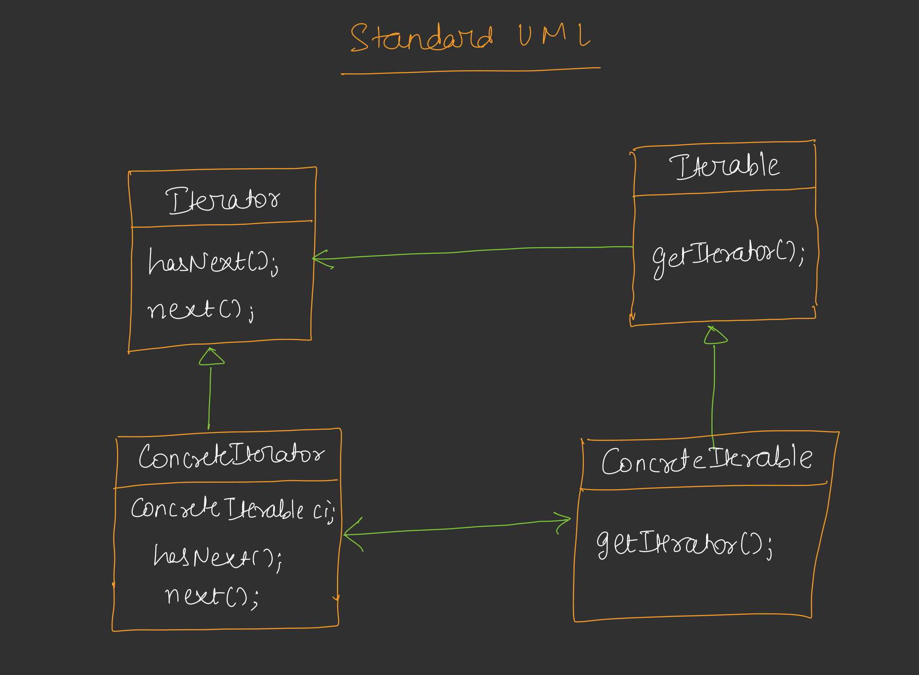
15. ITERATOR DESIGN PATTERN ITERATOR PROVIDES A WAY TO ACCESS THE ELEMENTS OF AN AGGREGATE OBJECTS SEQUENTIALLY WITHOUT EXPOSING ITS UNDERLYING REPRESENTATION.

Slide 41
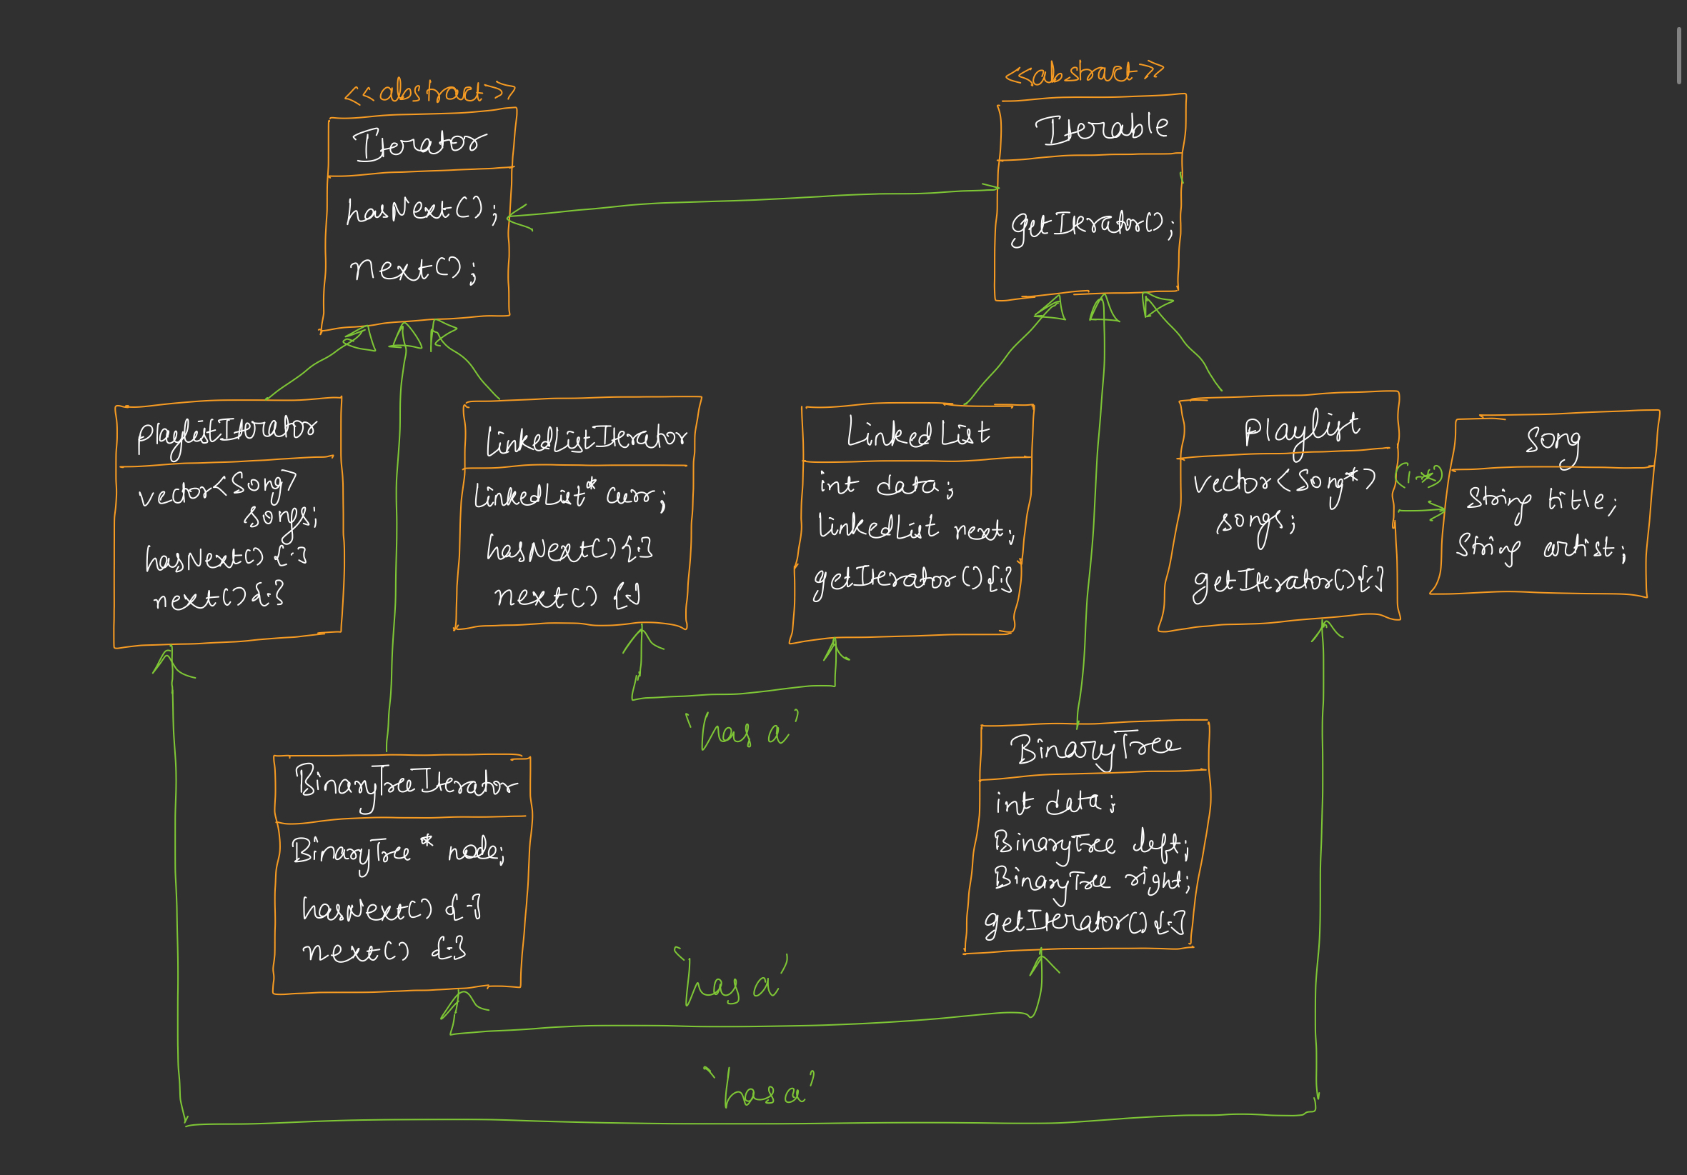
EXAMPLE UML

Slide 42
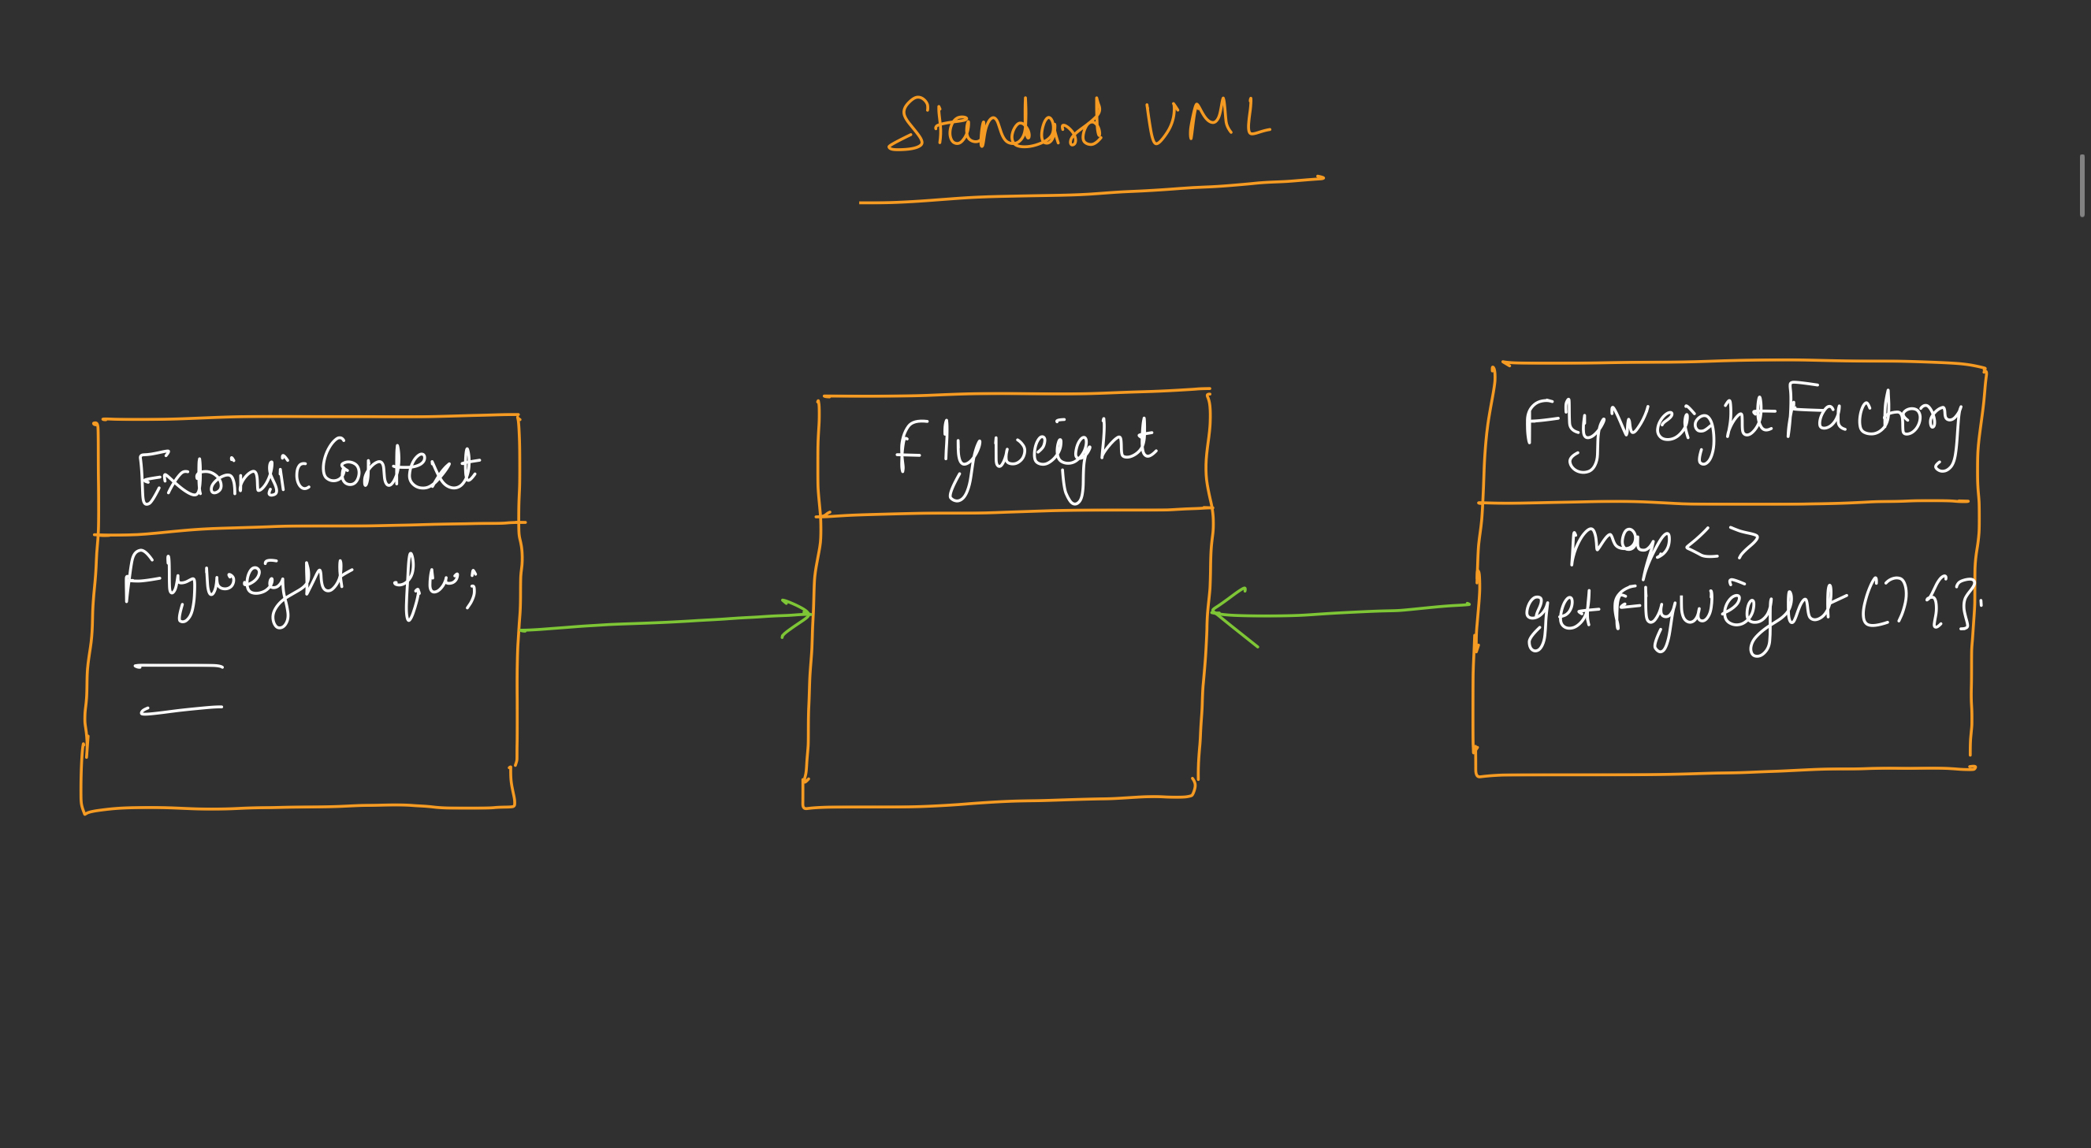
16. FLYWEIGHT DESIGN PATTERN IT USES SHARING TO SUPPORT LARGE NUMBER OF FINE-GRAINED OBJECTS EFFICIENTLY. INTRINSIC STATE: SHARED AMONG OBJECTS EXTRINSIC STATE: SUPPLIED BY CLIENT EXTERNALLY

Slide 43
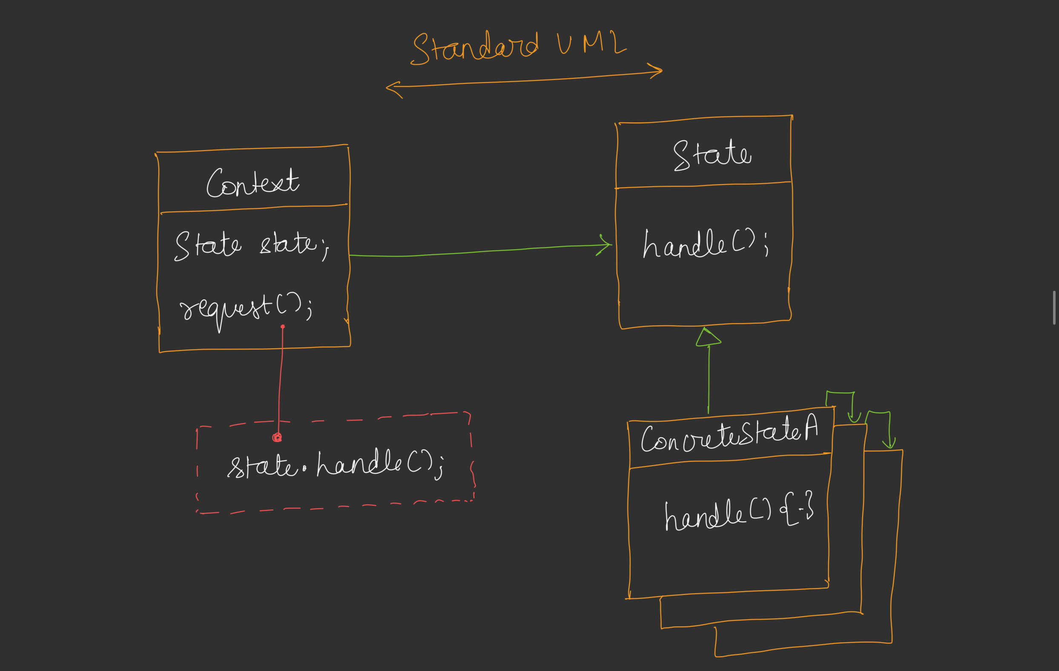
17. STATE DESIGN PATTERN IT ALLOWS AN OBJECT TO ALTER ITS BEHAVIOR WHEN ITS INTERNAL STATE CHANGES. THE OBJECT WILL APPEAR TO CHANGE THE CLASS.

Slide 44
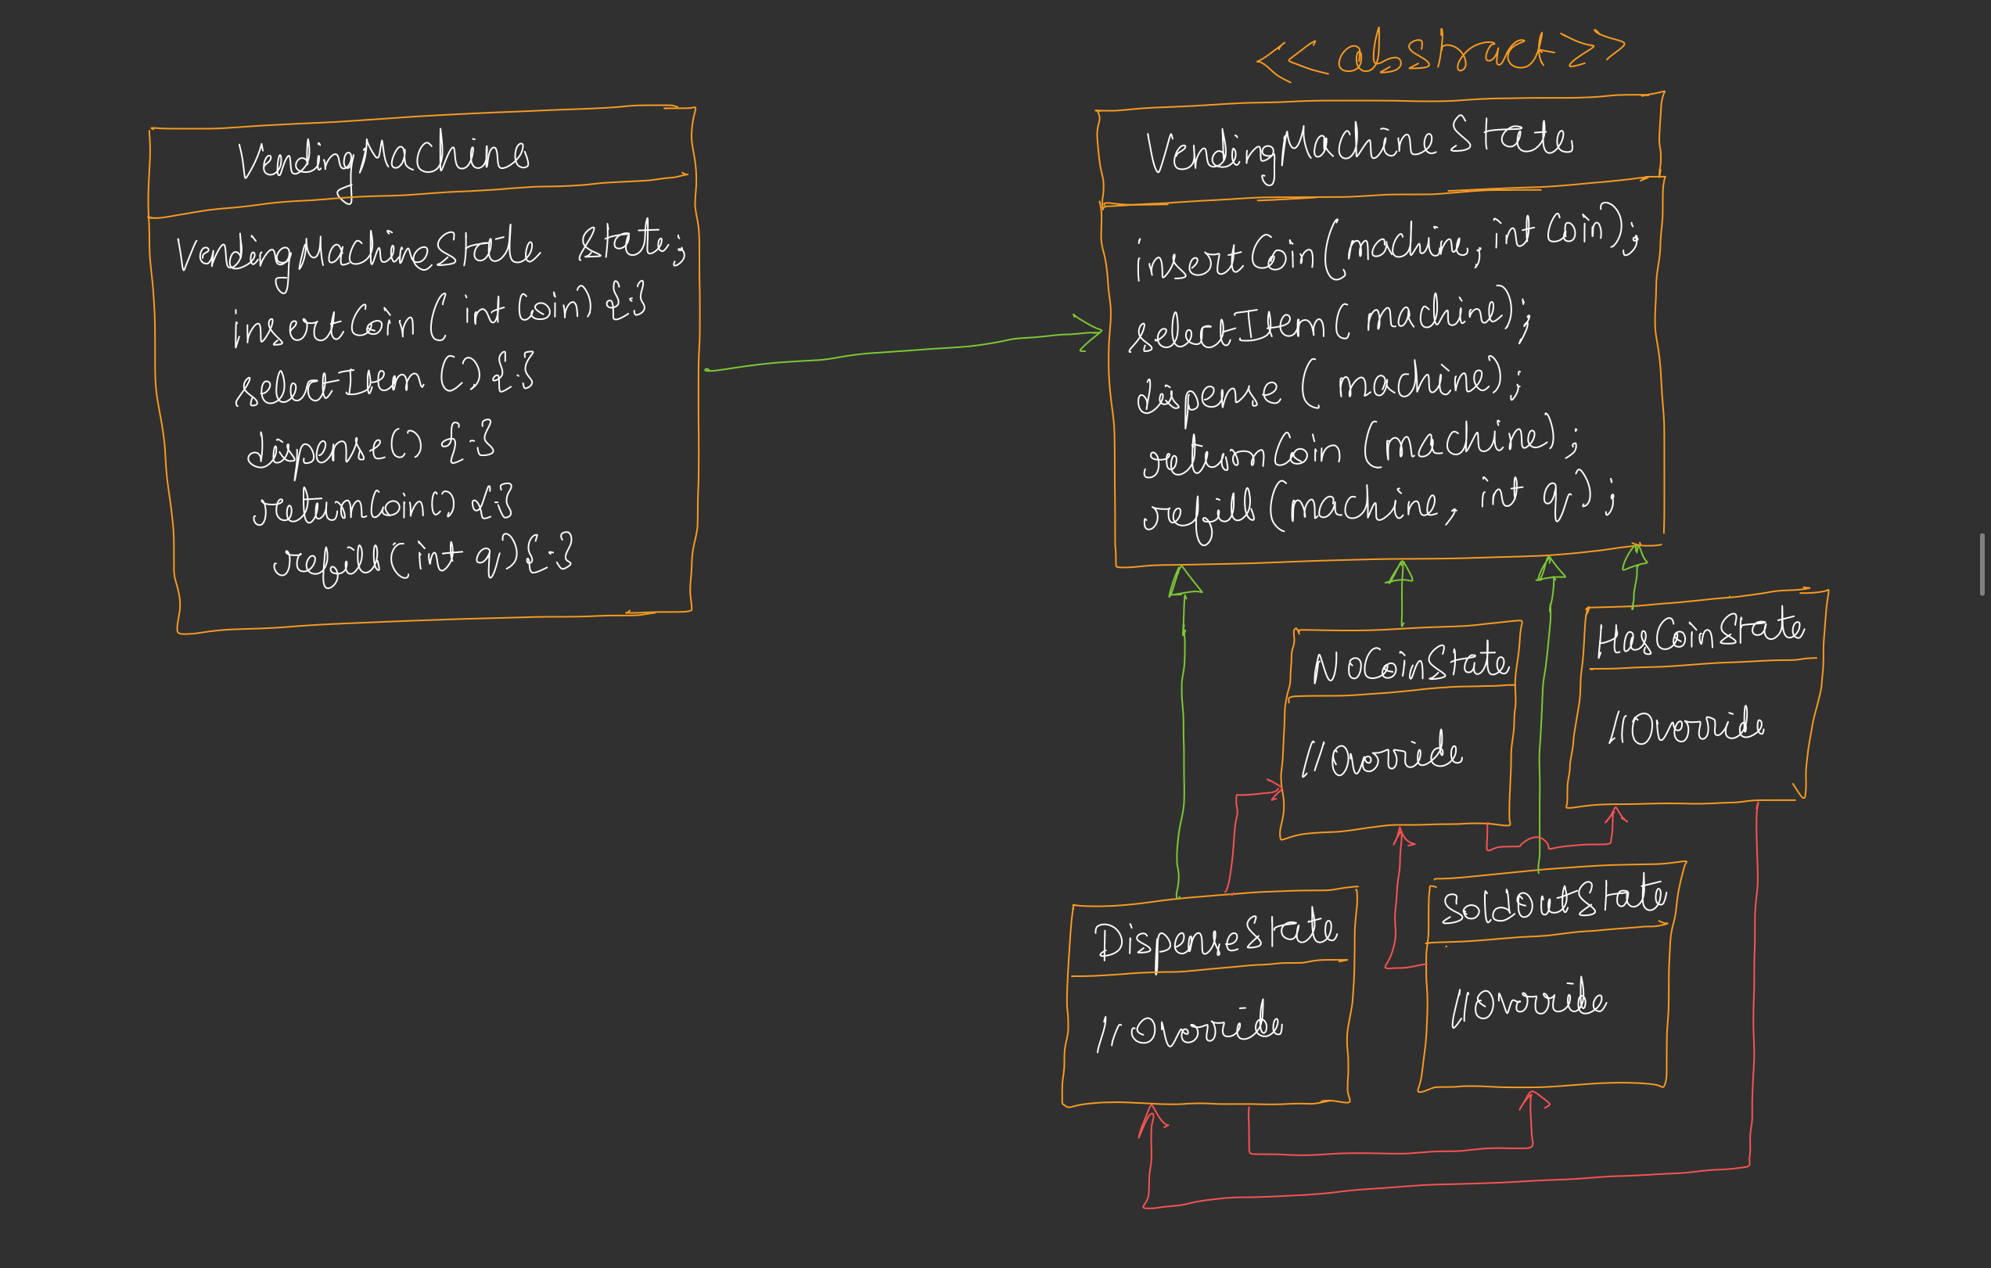
EXAMPLE UML

Slide 45
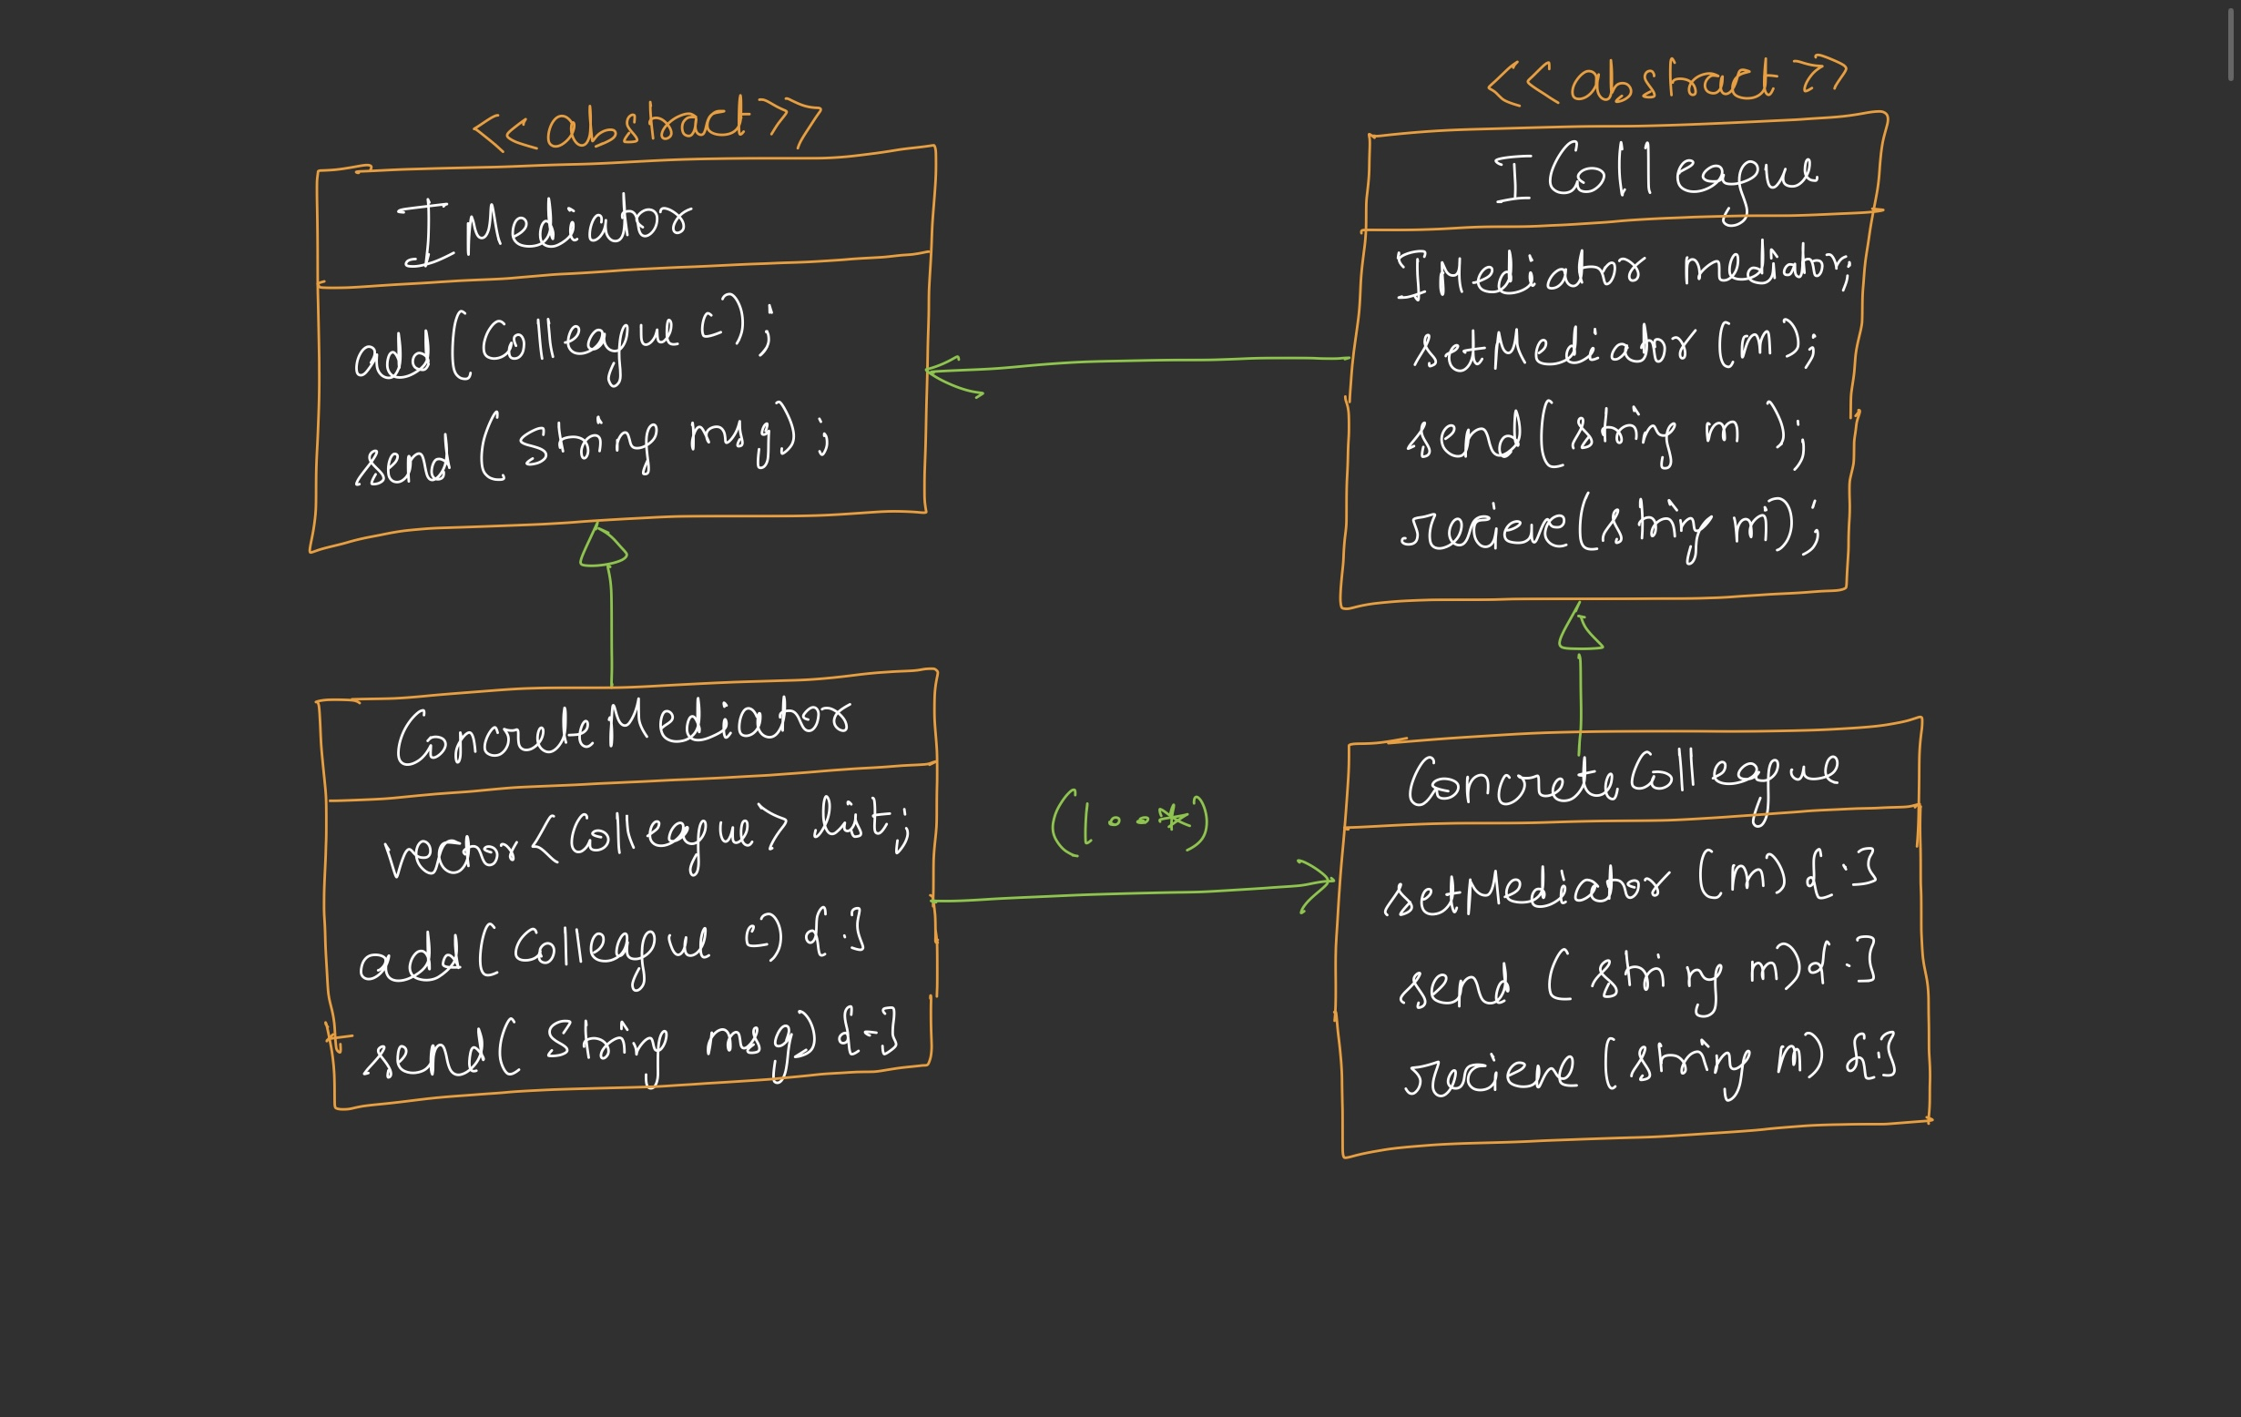
18. MEDIATOR DESIGN PATTERN IT DEFINES AN OBJECT THAT ENCAPSULATES HOW A SET OF OBJECTS INTERACT, AND PROMOTE LOOSE COUPLING BY PREVENTING THEM FROM REFERRING TO EACH OTHER.

Slide 46
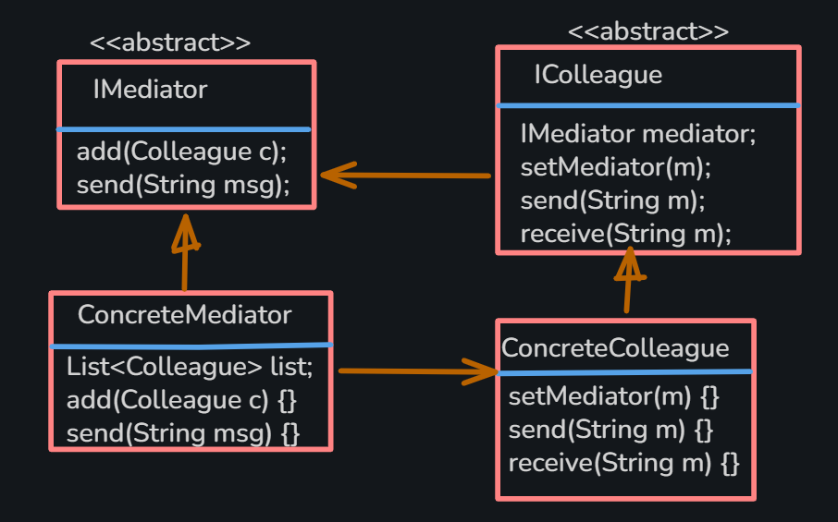
EXAMPLE UML

Slide 47
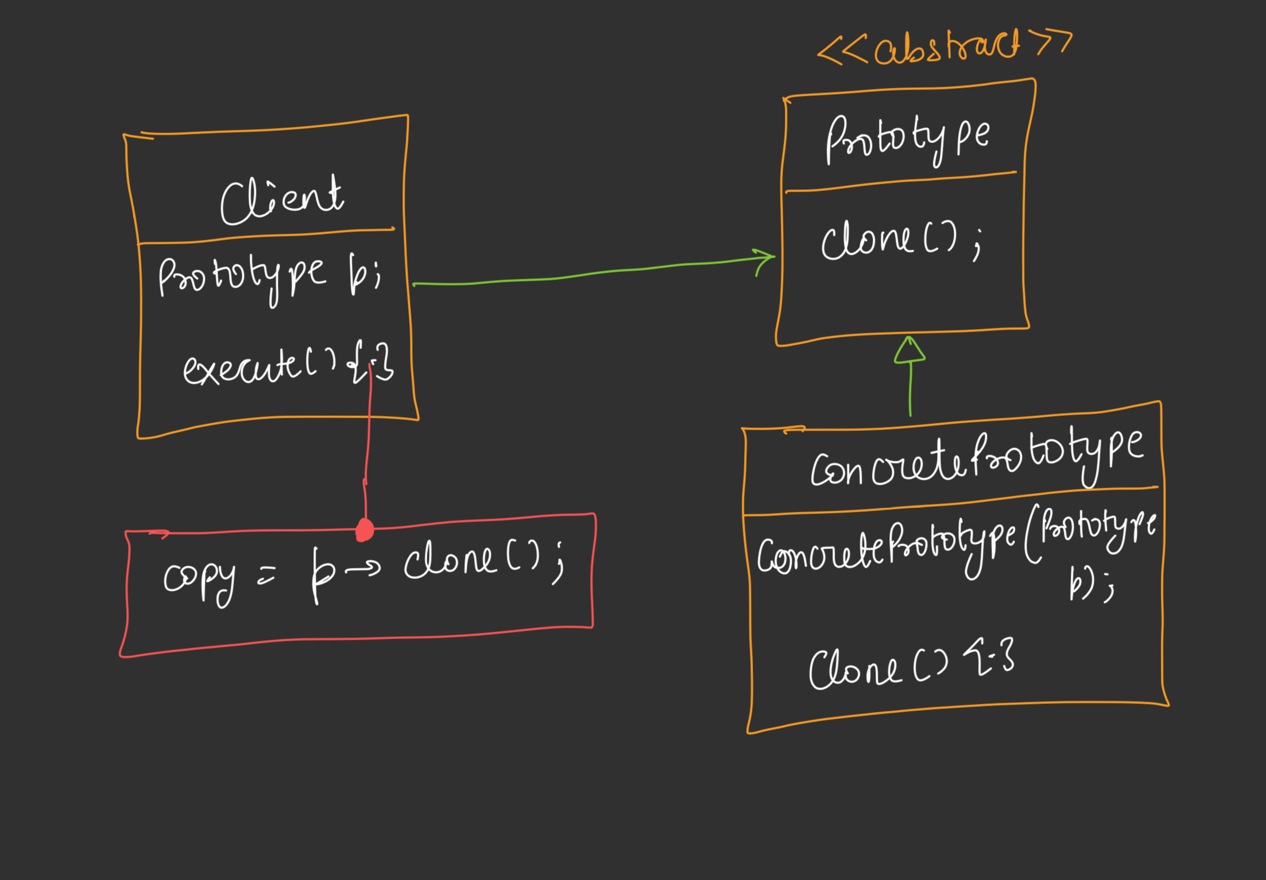
19. PROTOTYPE DESIGN PATTERN IT LET YOU CREATE NEW OBJECT BY COPYING (CLONING) ANOTHER INSTANCE.

Slide 48
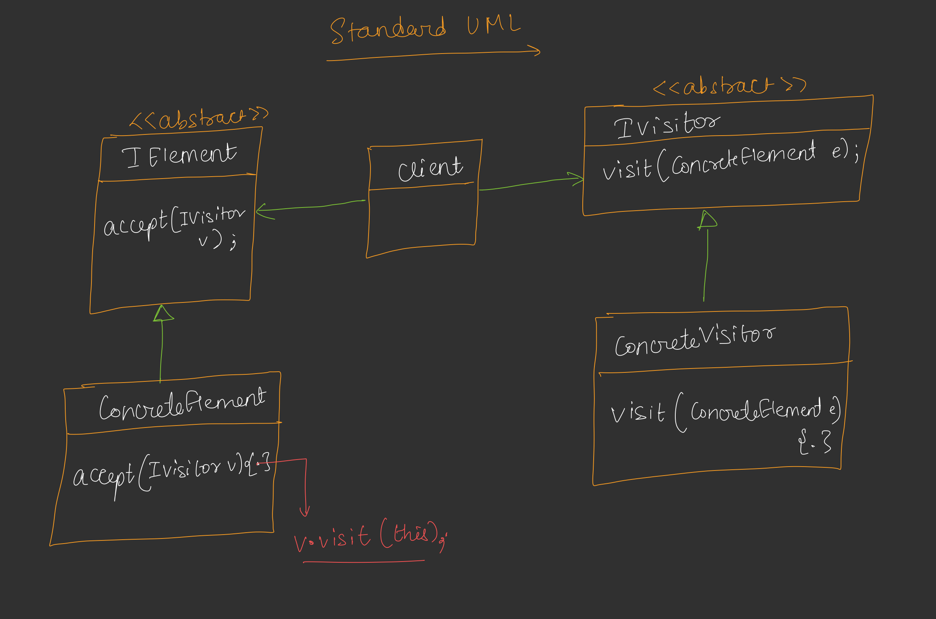
20. VISITOR DESIGN PATTERN IT ALLOWS TO ADD NEW OPERATION TO EXISTING CLASSES WITHOUT CHANING THEIR STRUCTURE. SEPARATES OPERATION FROM THE OBJECT IT OPERATES.

Slide 49
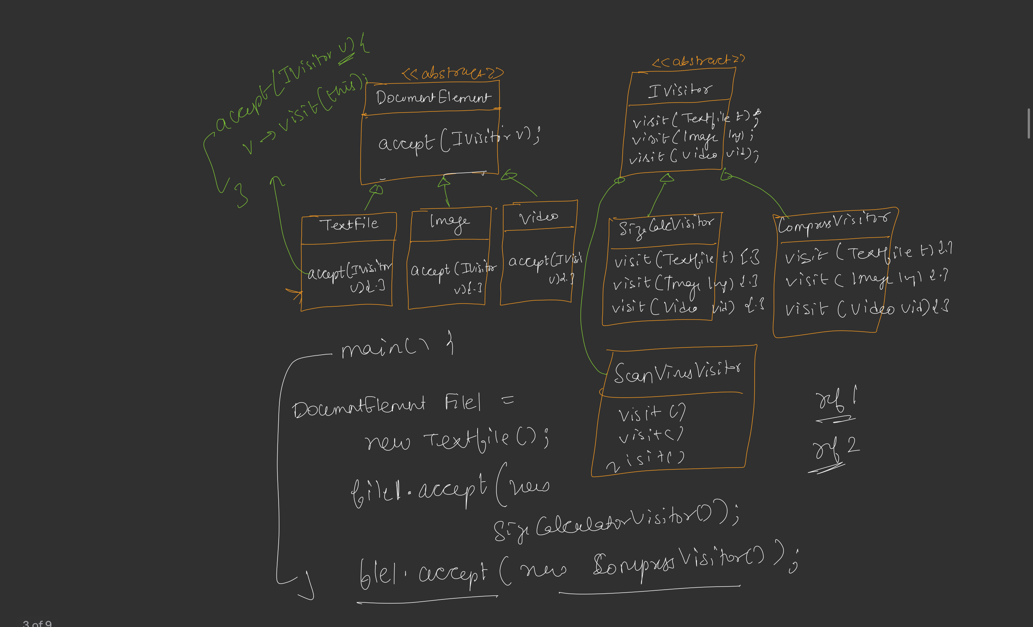
EXAMPLE UML

Slide 50
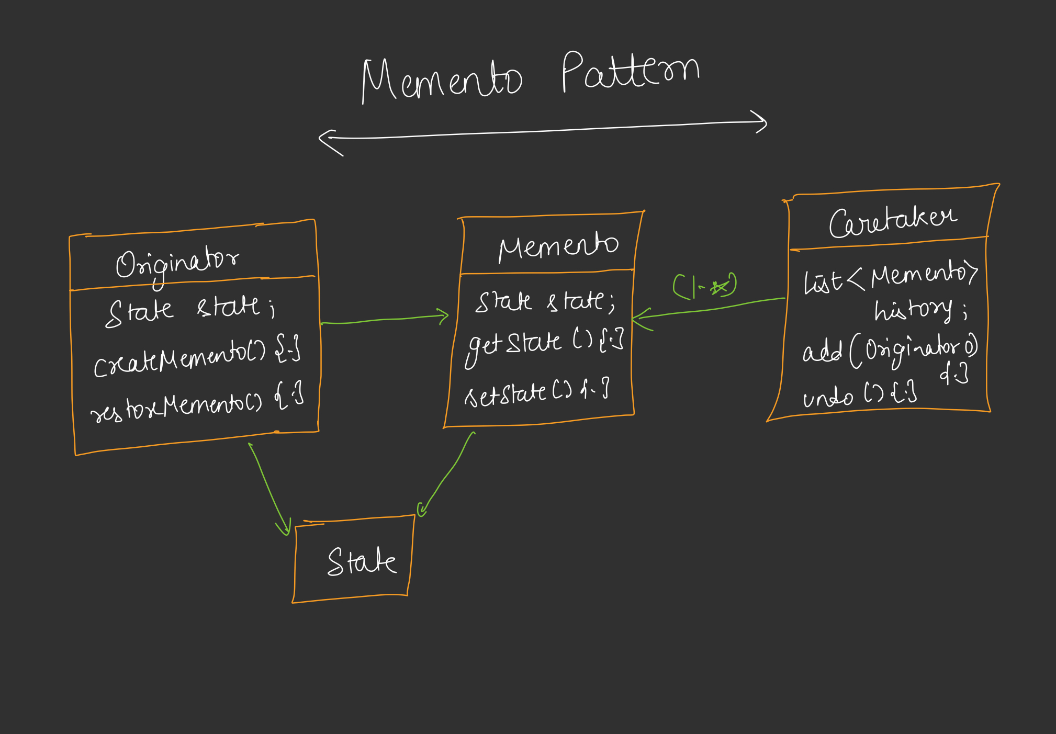
21. MEMENTO DESIGN PATTERN IT PROVIDES AN ABILITY TO TAKE SNAPSHOT OF AN OBJECT AT VARIOUS POINT IN TIME AND PROVIDE UNDO CAPABILITIES TO A PREVIOUS STATE.

Slide 51
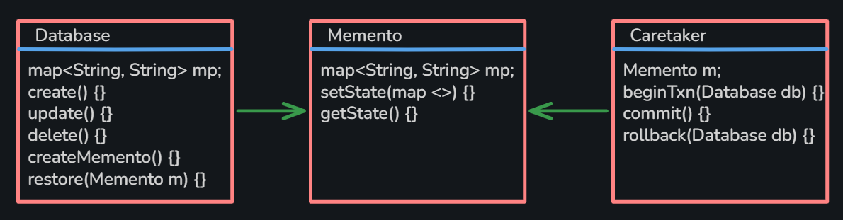
EXAMPLE UML

Slide 52
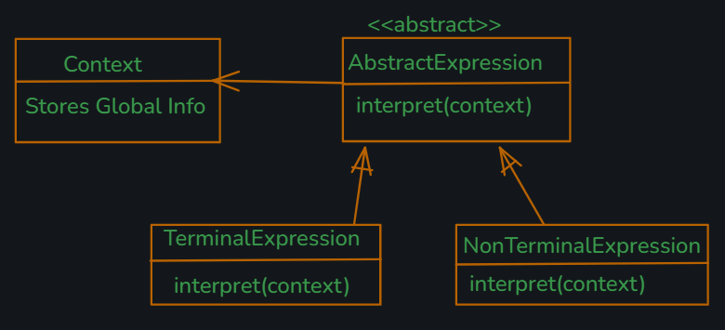
22. INTERPRETER DESIGN PATTERN IT DEFINES A GRAMMAR FOR A LANGUAGE AND REPRESENTS EACH GRAMMAR RULES AS A CLASS. IT PROVIDES AN INTERPRET() TO EVALUATE EXPRESSIONS, MAKING IT SUITABLE FOR ARITHMETIC EVALUATORS, RULE ENGINES, QUERY PROCESSORS, AND SIMPLE DOMAIN-SPECIFIC LANGUAGES (DSLs).

Slide 53
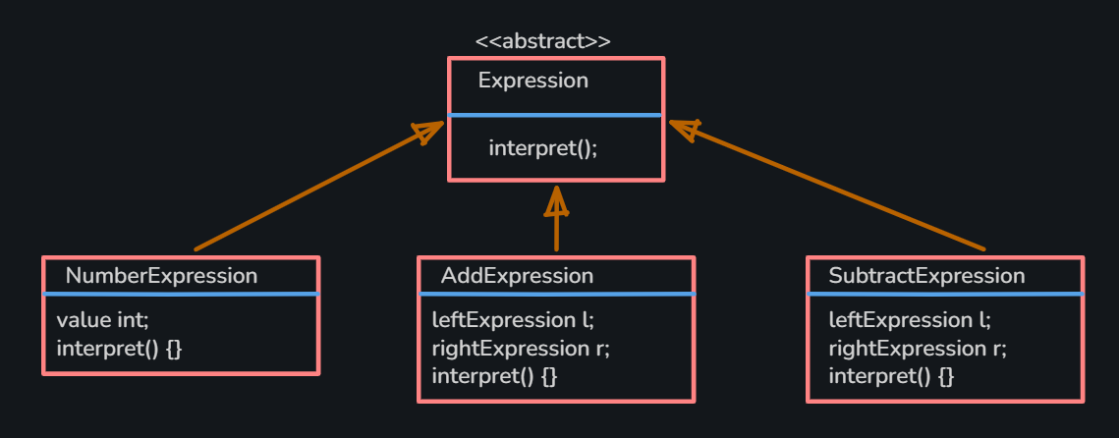
EXAMPLE UML

Slide 54



THANK YOU
SOURAV KUMAR PANDA

